Slide 1
May 2025 |
Stakeholder Service
Meeting
[Region]

Slide 2



Welcome and introduction
Welcome everyone
Housekeeping
Emergency exits / meeting place
Toilets
Apologies

Slide 3
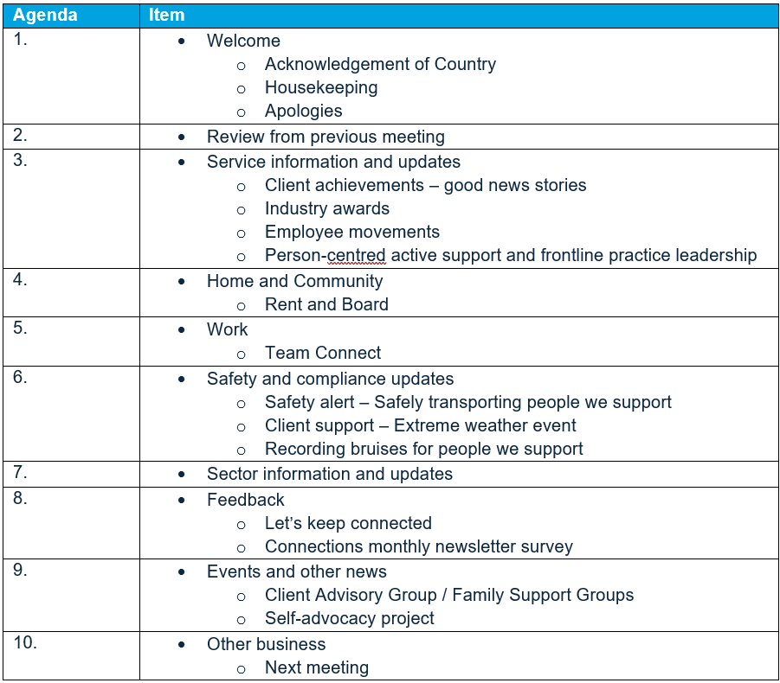
Agenda

Slide 4

Acknowledgement of Country
Acknowledgement of people with disability
Endeavour Foundation acknowledges the Traditional Custodians of the land on which we live, work and play, and their continuing connections to land, sea and community. We pay our respects to Elders past and present and extend that respect to all Aboriginal and Torres Strait Islander peoples today.
We recognise the role that people with disability, their families and supporters play in their communities. We acknowledge the structural inequalities that have contributed to their exclusion from social, economic and community participation. We work towards inclusion and upholding their human rights.
JOY
QArt’s Mya Wilson,
Wurundjeri artist
“This idea for this painting was conceived during the Covid pandemic. I wanted to express the disharmony and the multiple challenges that people faced during this time. This is a contrast to the Dreamtime when all living creatures lived harmoniously and sustainably on the land and in the sea. I have used modern bright pastel colours to lighten the mood. The intention is to create a feeling of happiness, growth and hope.”

Slide 5
Review from previous meeting

Slide 6




Review from previous meeting
Family support
Communication with stakeholders
Food quality and nutrition
Site environment / facility

Slide 7
Service information and updates

Slide 8
Client achievements | Good news stories
[Insert content here]

Slide 9
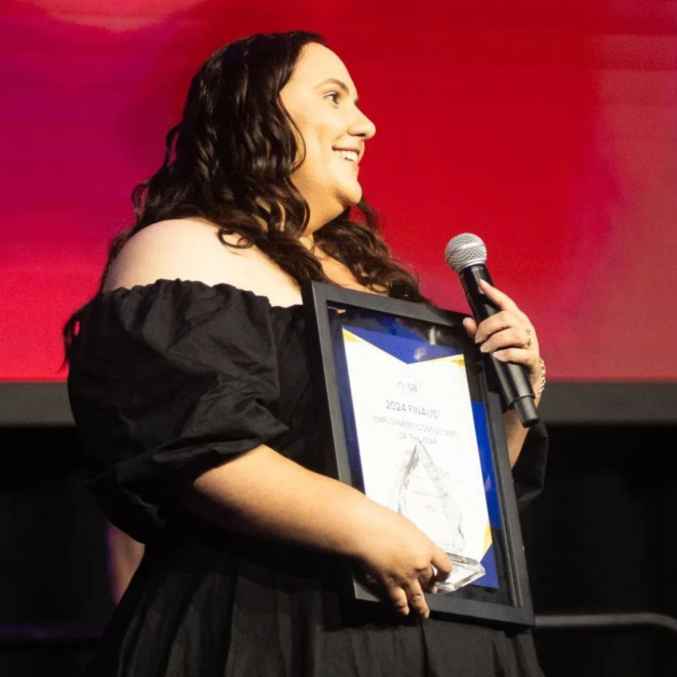
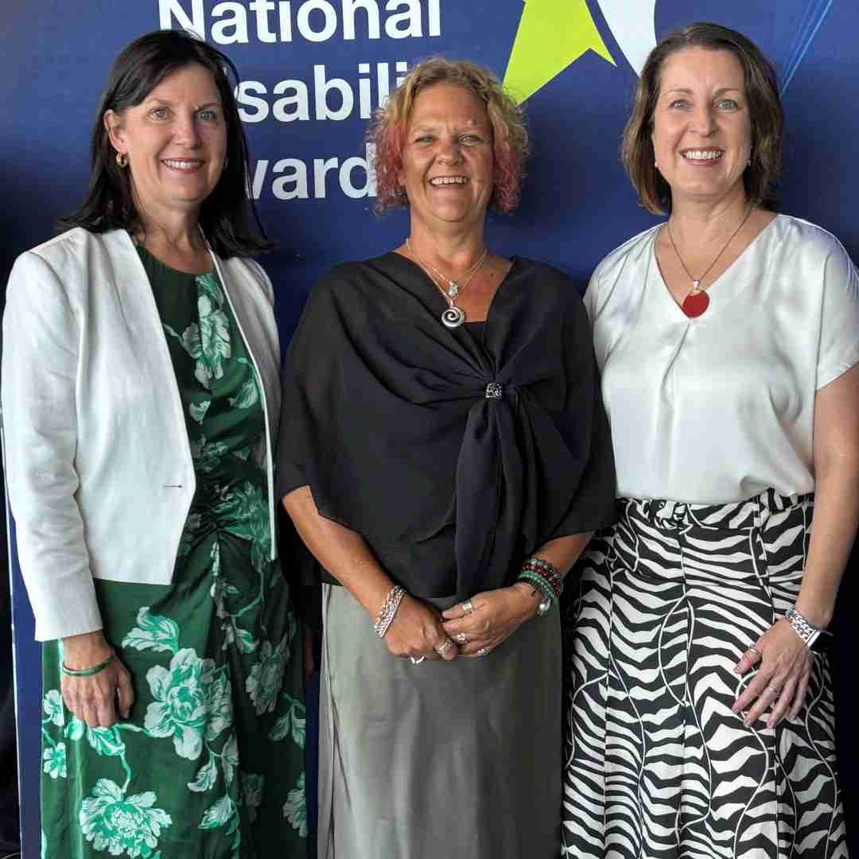
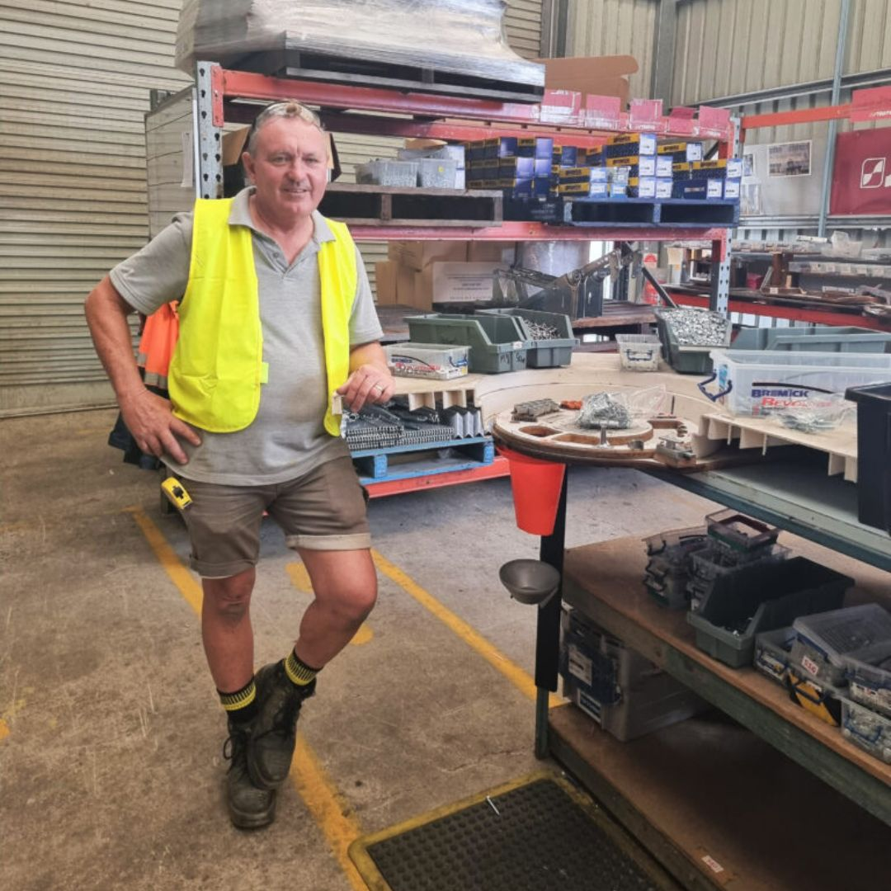
Industry awards
NESA Awards for Excellence | Employment Consultant of the Year | Winner – Charissa List (Employment Consultant – Yeppoon)
National Disability Awards | Excellence in Disability Support | Finalist – Lisa Van Sitter (Site Manager – Alex Hills L&L)
National Disability Awards | Excellence in Disability Support | Highly Commended – David Cooper (Production Team Leader – Southport social enterprise)

Slide 10
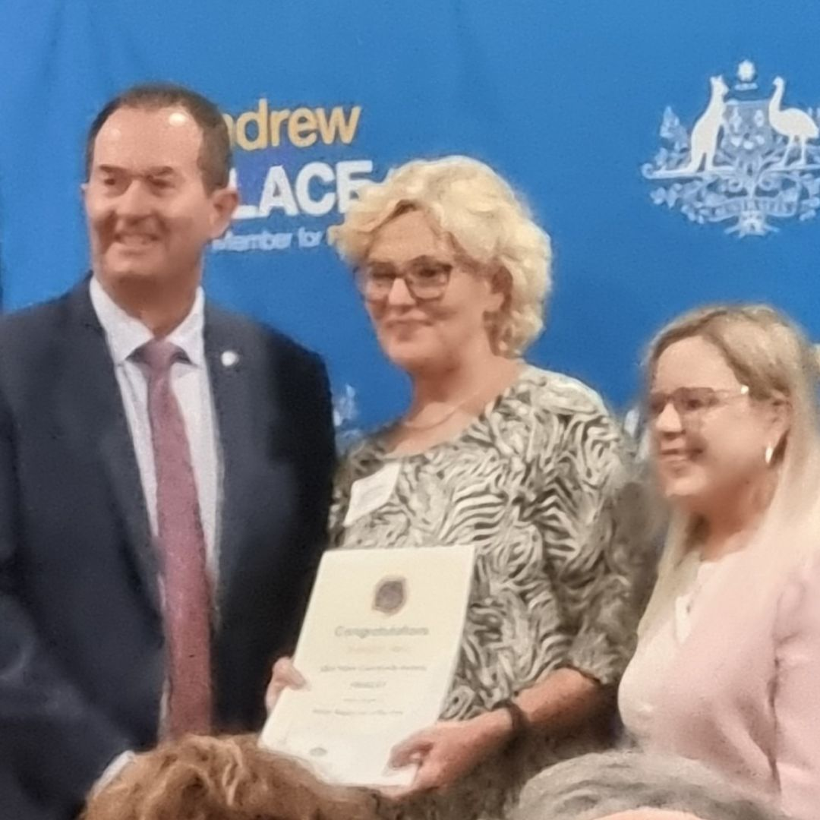

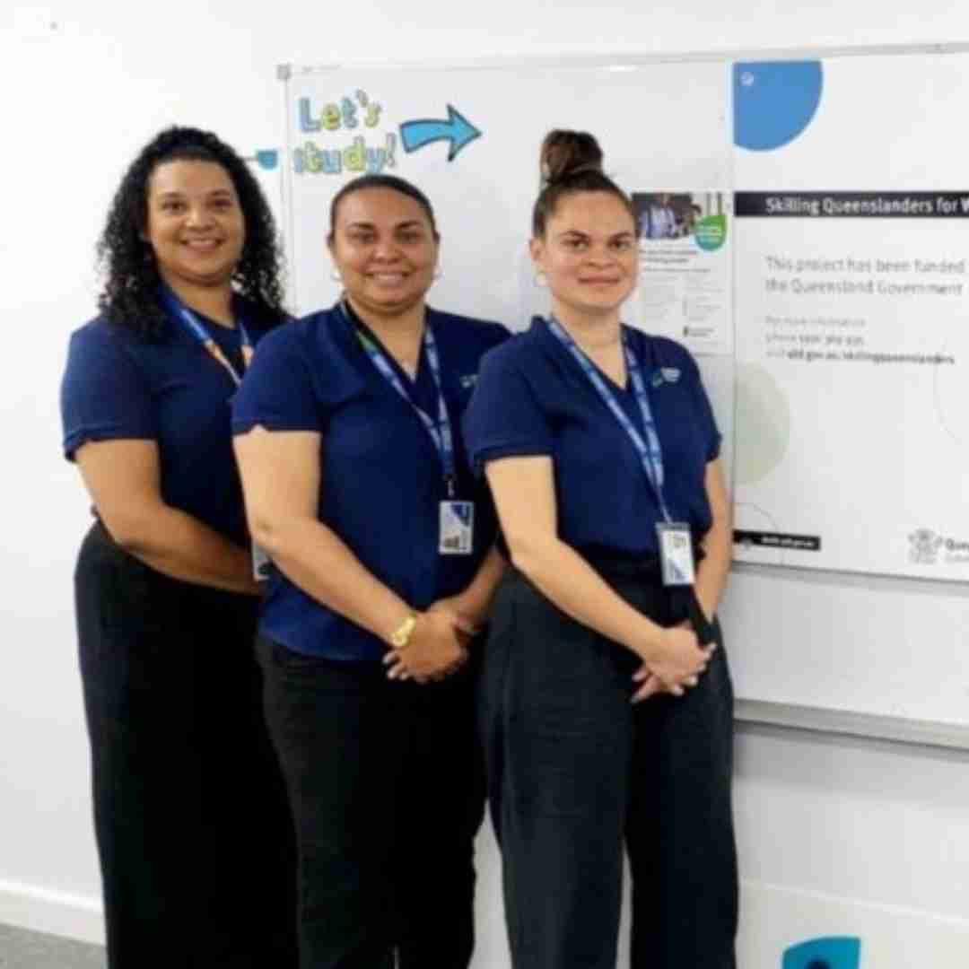
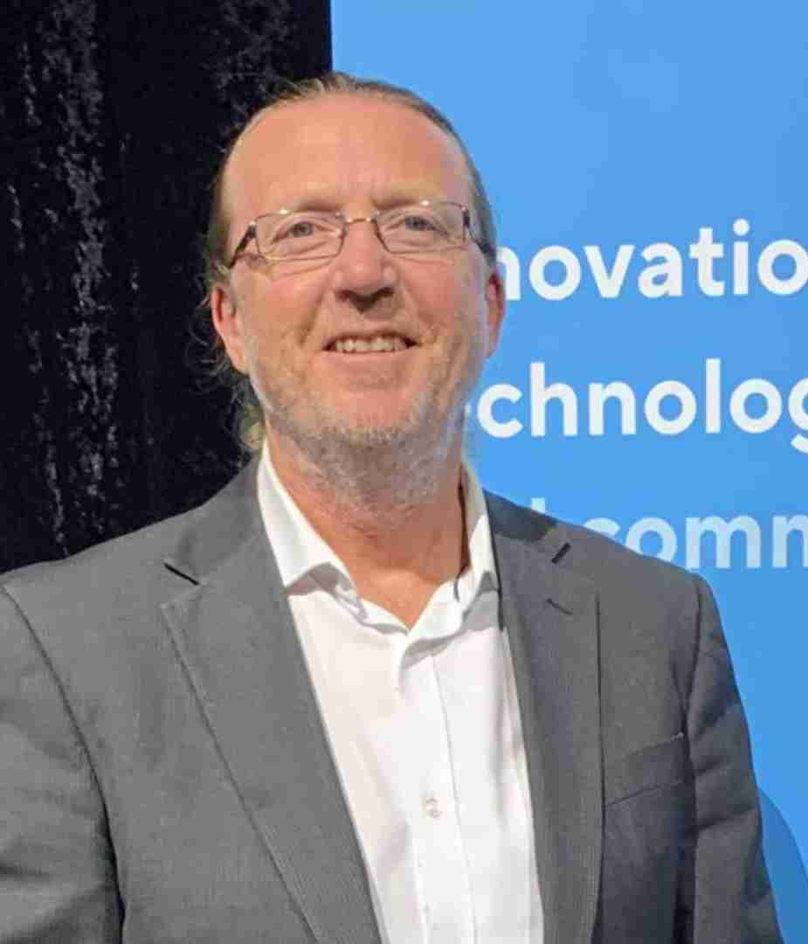
Industry awards
Fisher Community Awards | Community Service Award | Finalist – Jenny Moss (Support Coordination Team Leader – Bokarina)
Queensland Training Awards | Indigenous Student of the Year | Regional Winner – Clayton Lavis
Queensland Training Awards | Training initiative of the Year | Regional Finalist – Mackay SQW team
Innovation and Technology Awards | Excellence in Digital Workforce Development | Winner – Service Design

Slide 11
Employee movements
[Insert content here]

Slide 12




Person-centred active support and frontline practice leadership
We are moving away from old ways of thinking to focus on a modern, person-centred approach
It recognises that each person has unique support needs and goals
It ensures that our practices reflect our organisational goals
It allows us to:
Prioritise safety
Boost quality of life
Ensure consistency
Invest in the upskilling of employees and leaders

Slide 13
Home and Community

Slide 14
Rent and Board
[Insert content here]

Slide 15
Work

Slide 16





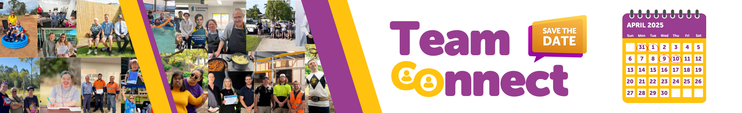
Team Connect
March / April was our first all employee, fully inclusive Team Connect
Team Connect connects employees to the Executive Leadership team to hear about where the organisation is heading
Online forum where there is a formal part of the session and an open Q&A session
We have made it inclusive in a number of ways
Team Connect aligns with our strategic outcomes of included and employed

Slide 17
Safety and compliance updates

Slide 18

January – March 2025
This year we have released a number of safety alerts / practice bulletins including:
  Safety Alert | Transporting people we support
  Practice Bulletin | Client support - Extreme weather event
  Practice Bulletin | Recording bruises for people we support
  Practice Bulletin | Reportable incidents

Slide 19
Sector information and updates

Slide 20
Feedback

Slide 21



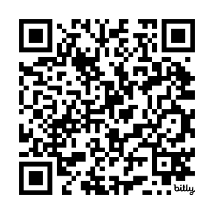
Let’s keep connected
We want to ensure you receive information from us that is important to you and the person you support
You can update your contact details by:
Emailing – changemydetails@endeavour.com.au
Phone the National Contact Centre on 1800 112 112 and the team will update your details on our system
Scan the QR code for our Stakeholder Company Directory

Slide 22

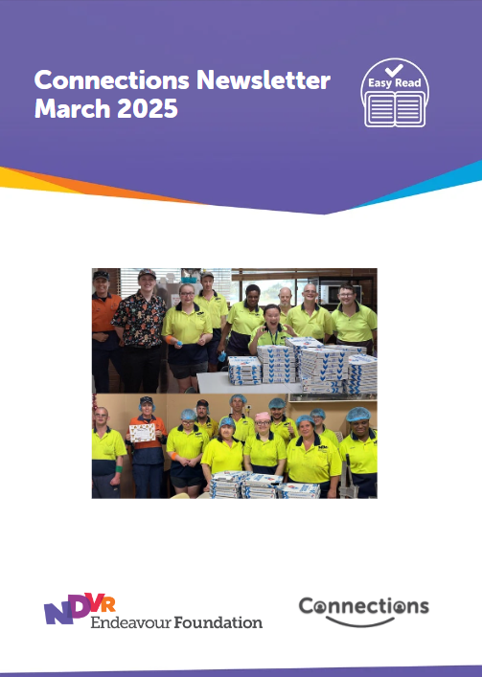



Connections survey
Connections is a monthly newsletter to families and carers that connects you to us, allowing us to share stories, sector news and updates from Endeavour Foundation
Connections is also distributed to people we support in Easy Read format and employees we support in plain English/Easy Read format
We have just completed a survey where we asked people what they like about Connections and how we can improve
We will use the feedback we received to help us to shape and improve future editions
If you’re not receiving Connections and would like to, please let the Communications and Engagement team know

Slide 23
Events and other news

Slide 24



Client Advisory Groups
Our Client Advisory Group has now been established with 4 members
The aim of the group is to provide a valuable, client-led perspective on our policies and procedures to help ensure our services are relevant, effective and responsive to people’s needs, preferences and concerns.
The Client Advisory Group provide feedback and identify areas for improvement on client-related matters including:
  policies and procedures
  new programs or services
  Advocacy positions
  Employee recruitment and training
  Easy-Read documents

Slide 25




Family Support Groups
Family Support Groups are an opportunity for families and carers to connect, share and discuss things that are important to you
We are currently hosting some sessions in South-East Queensland where we are gathering feedback on how we are best to set these up
We want to add value to these groups and one of the ways we can do this is by facilitating a series of educational talks led by internal and external experts.
These groups are designed to be managed by you, focusing on topics that matter most to your local community. You will have the autonomy to shape and lead these groups as you see fit.

Slide 26




Self-advocacy project
This new project will help people with intellectual disability to speak up on important issues and advocate for themselves.
It aims to empower people by educating them on their rights and helping develop skills to exercise these rights.
The project will:
Support a network of self-advocates and help them to speak up
Deliver workshops for people to understand and exercise their rights
Produce new online learning modules on rights and advocacy
Train staff in how to facilitate self-advocacy and access independent advocates
The project is commencing now and will roll out over the 2025-2026 financial year.

Slide 27
Events and key calendar dates
[click to add date]

Slide 28
Other business

Slide 29


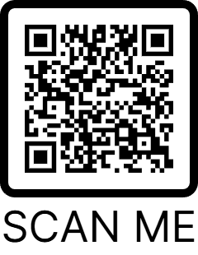


How did we do?
We would love you to give us some feedback on how the session went today.
This will allow us to be able to see if the topics were relevant to you and what you’d like to talk about in the future.
Scan the QR code for the survey.
It only takes about 5 minutes.

Slide 30
Next meeting
[click to add date]

Slide 31
Thank you!

