Slide 1
Celebrating First Nations Science & Technology
NAIDOC Week Hall of Fame 2024

Slide 2
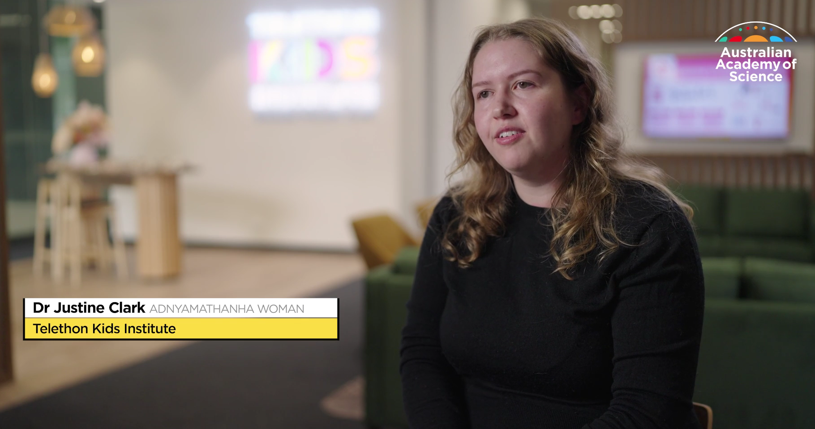

Precision Cancer Research

Slide 3
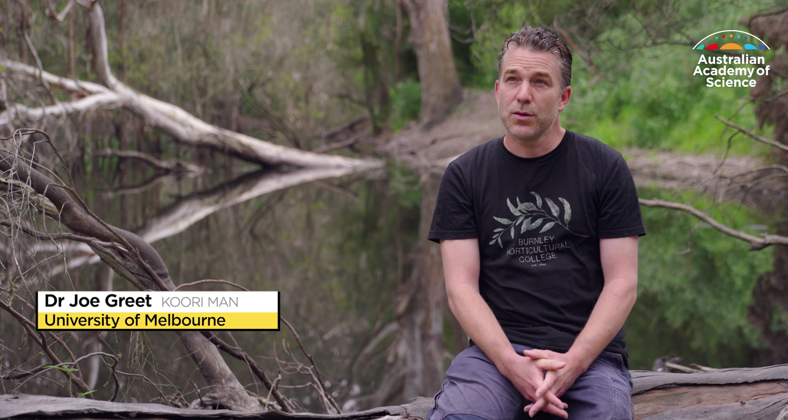
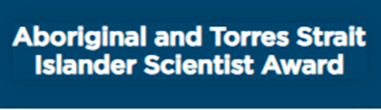
Wetland Health & Sustainability

Slide 4
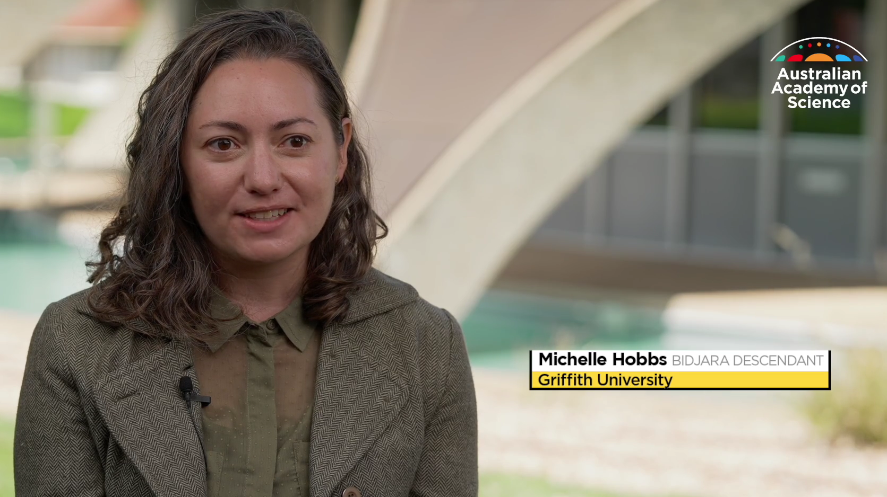

Freshwater Ecosystem Management

Slide 5
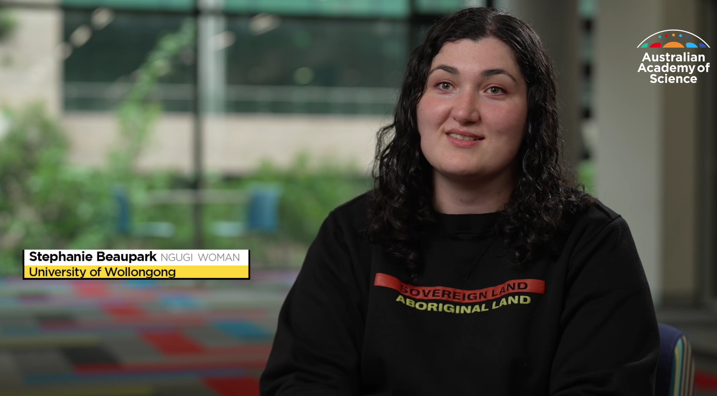
Colour Chemistry of Natural Dyes

Slide 6
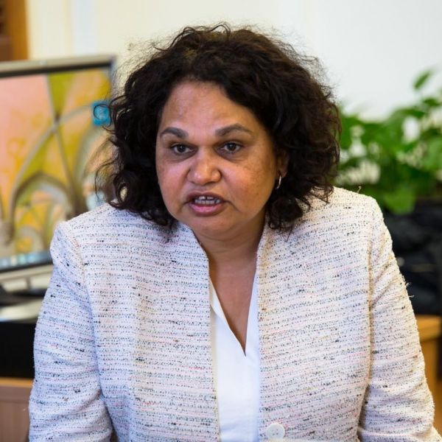
Professor Sandra Eades is a Noongar woman from Mount Barker, WA.
She completed her medical degree in 1990 and after working as a GP, started her career in health research at the Telethon Kids Institute.
In 2003 she became Australia's first Aboriginal medical doctor to be awarded a PhD.
Her PhD investigated the causal pathways and determinants of health among Aboriginal infants in the first year of life.
Professor Eades was named NSW Woman of the Year 2006 in recognition of her research contributions to Aboriginal communities and has received a 'Deadly Award' (National Aboriginal and Torres Strait Islander Awards) for Outstanding Achievement in Health.
As well as Associate Dean (Indigenous), she is a Professor at the Centre for Epidemiology and Biostatistics, Melbourne School of Population and Global Health.

Slide 7
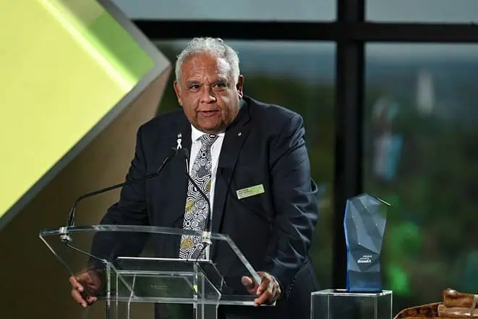
Professor Tom Calma AO is an Aboriginal elder from the Kungarakan tribal group and a member of the Iwaidja tribal group.
He has been a champion for the improvement and advancement of Indigenous peoples’ health, justice, education, and employment status.
His research interests include pharmacological application for scabies control, genomics, Indigenous cancers, tobacco control, and microbiome, as well as health, mental health, and suicide prevention.
Professor Calma received the 2023 Senior Australian of the Year award.

Slide 8
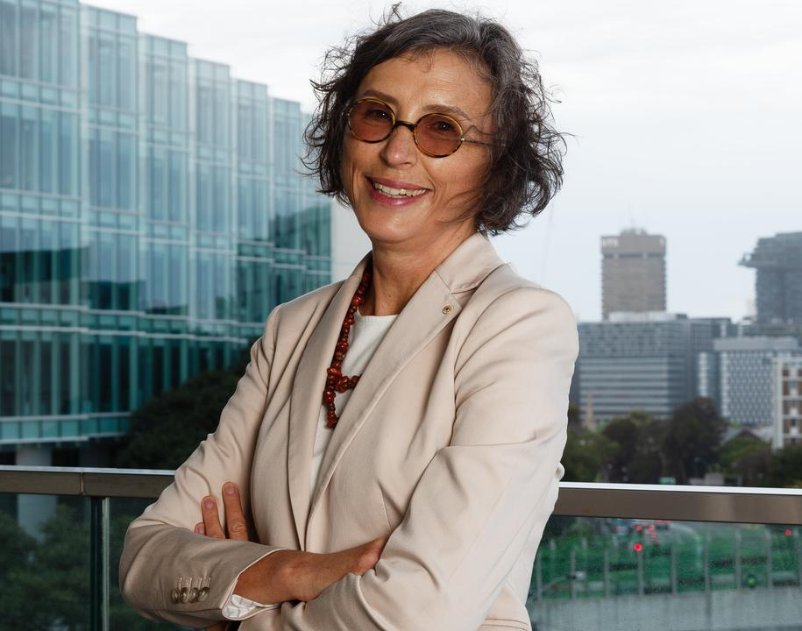
Lisa Jackson Pulver slept in cars and couch-surfed throughout her teen years before turning her attention to nursing.
The Wiradjuri Koori woman worked for decades in that profession, then she applied for the University of Sydney's medical program. Professor Pulver became the first Indigenous person to receive a PhD in medicine from the university.
That PhD, examining the lack of appropriate care given to Aboriginal and Torres Strait Islander people of Australia, informed the next phases of her career and helped her to become a fierce advocate for First Nations health research.
Her epidemiological research, which has been used by the World Health Organization, identified the wide array of health problems still affecting Indigenous Australians and ways to address inequities.
Her philanthropic contributions to several universities have built scholarship programmes providing opportunities for First Nations students.
She is currently deputy vice chancellor of Indigenous strategy and services at the University of Sydney.

Slide 9
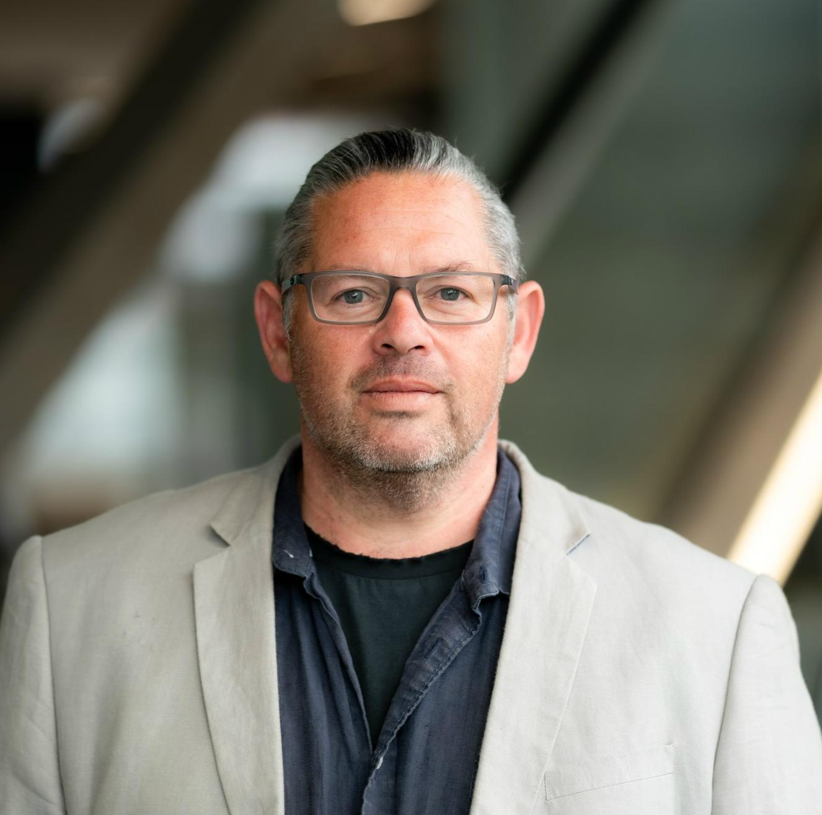
In March 2023, Professor Alex Brown become the first Indigenous member of the CSIRO Board.
Professor Brown is a leading Indigenous doctor and scientist with a strong focus on using cutting-edge science to improve health outcomes for Aboriginal and Torres Strait Islander people.
The CSIRO is Australia’s peak agency for science and technology and the Board is responsible for the strategic direction and performance of the organisation.
Professor Brown leads several important research projects to improve access to genomic medicine for Indigenous people through the collaborative Telethon Kids Institute – ANU program that he leads.

Slide 10
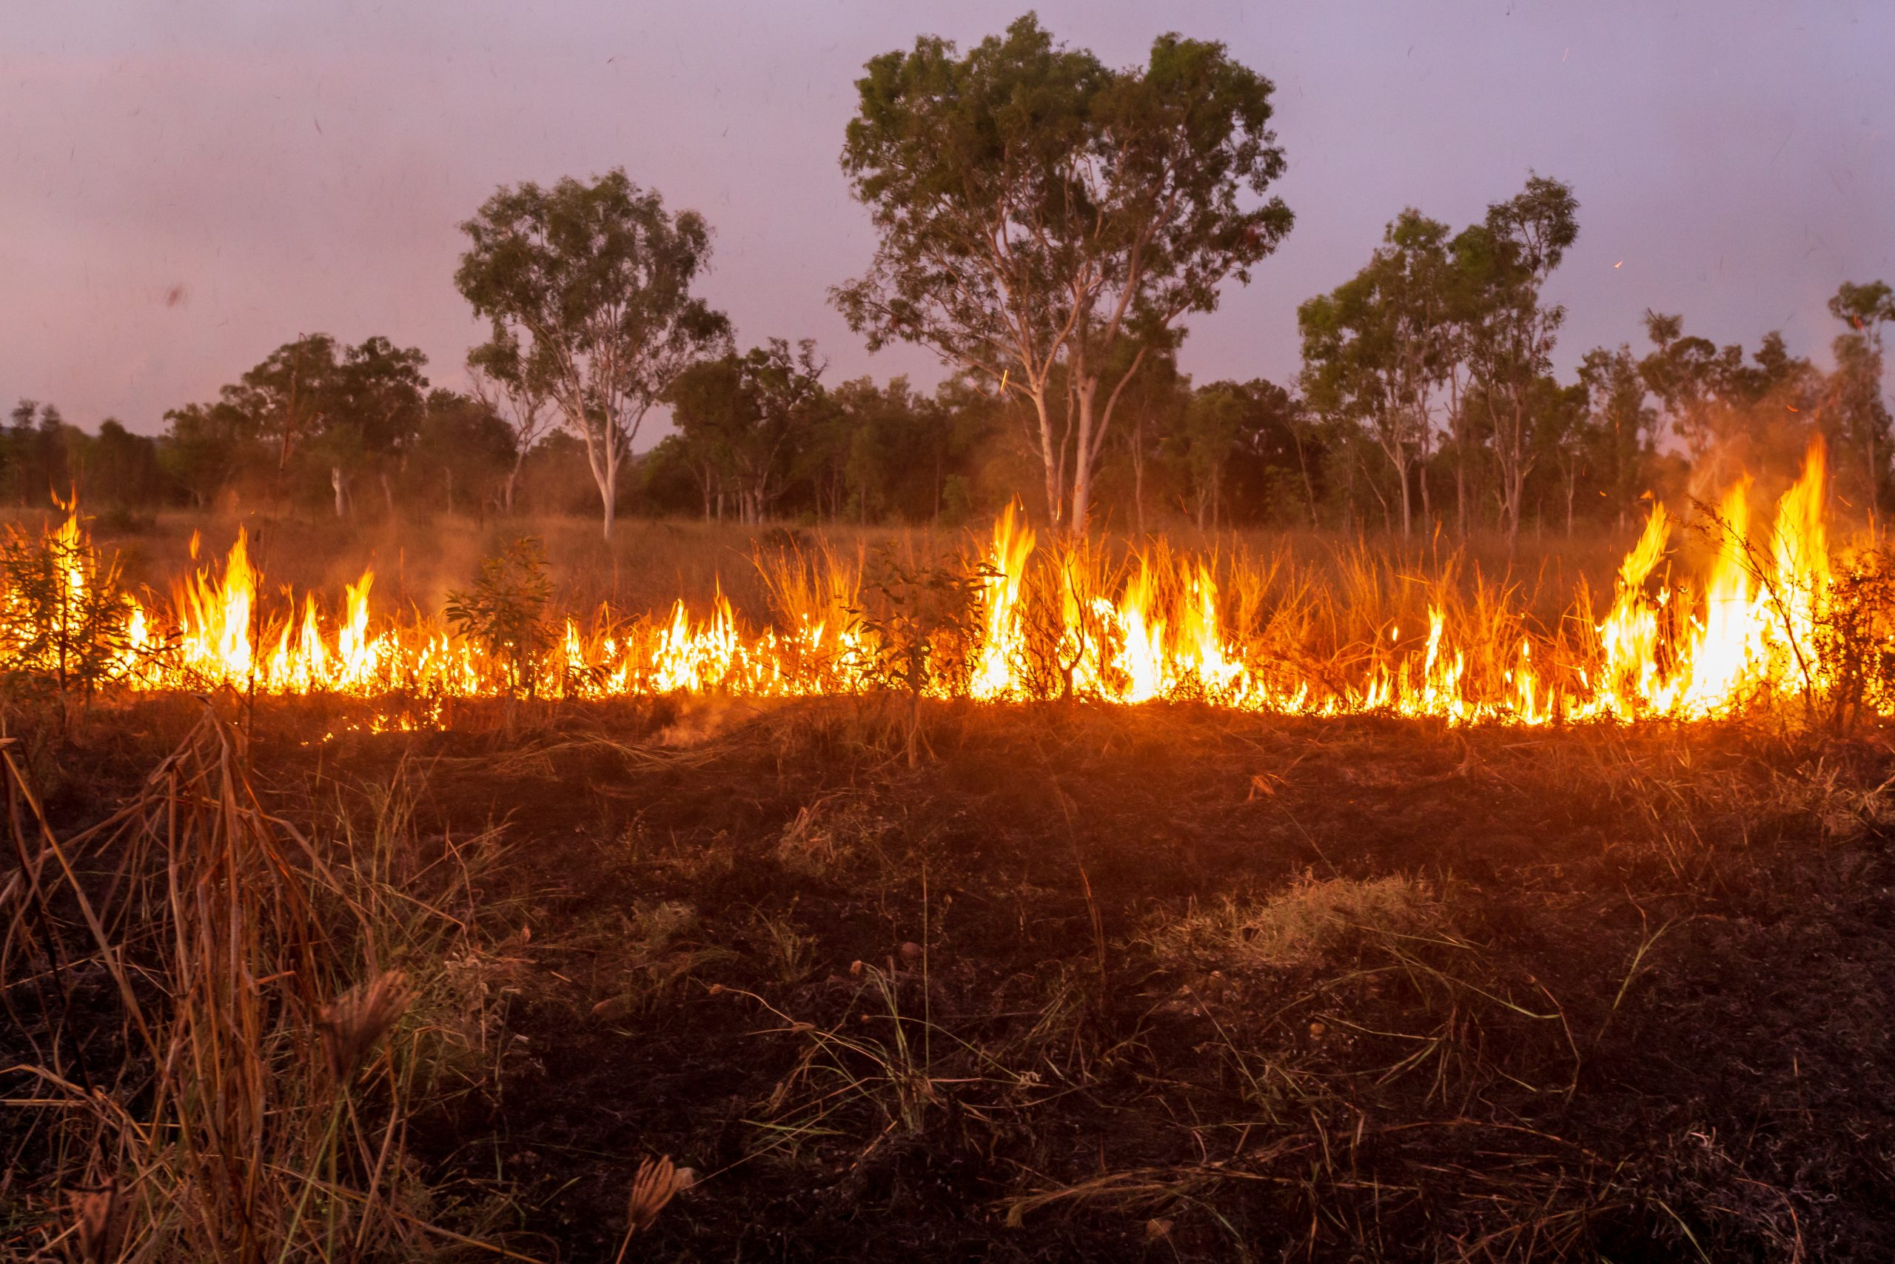
Aboriginal communities in the Kimberley region of Western Australia have been managing fire for millennia by lighting ‘cool’ fires in targeted areas at the beginning of the dry season.
The fires burn slowly, reducing the amount of fuel in the undergrowth and creating fire breaks while keeping most taller trees standing and maintaining habitat for wildlife.
When European colonizers took Aboriginal peoples from their land, large and uncontrolled wildfires began to break out later in the dry season, destroying ecosystems and often impacting pastures and infrastructure, too.
The Kimberley Land Council (KLC) has established an Indigenous fire management program in the land it oversees, using traditional knowledge and techniques alongside Western science and technology to burn carefully and reduce the risk of uncontrolled wildfires.

Slide 11
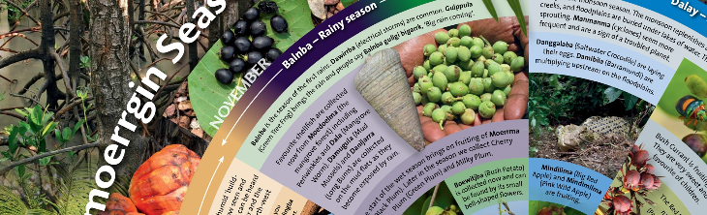
Aboriginal and Torres Strait Islander peoples, Australia’s First Scientists, have always held a deep understanding of the seasons, and of how to tell when seasons are changing.
Seasonal understanding of Country underpins many activities on Country. Recording this knowledge provides a powerful tool for Indigenous knowledge holders to demonstrate and communicate their connection to, use and management of Country.
Over the past fifteen years CSIRO has co-designed, refined and tested the application of a season calendar methodology with our Indigenous partners as a way of documenting and presenting seasonal understanding of Country.
The co-produced seasonal calendars have proven to be powerful tools in representing Indigenous understanding of, and connection to Country.

Slide 12
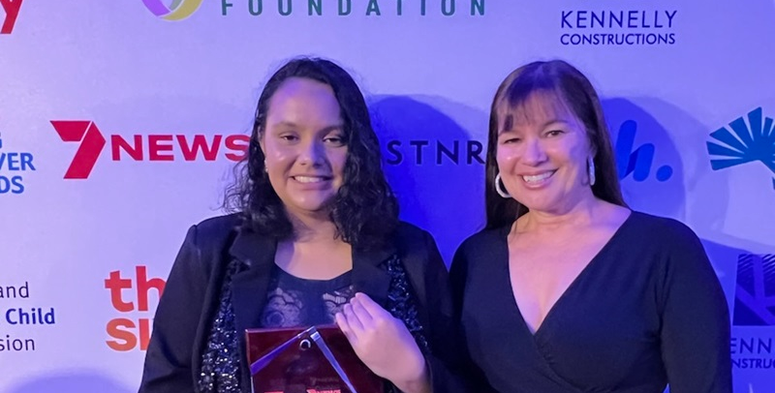
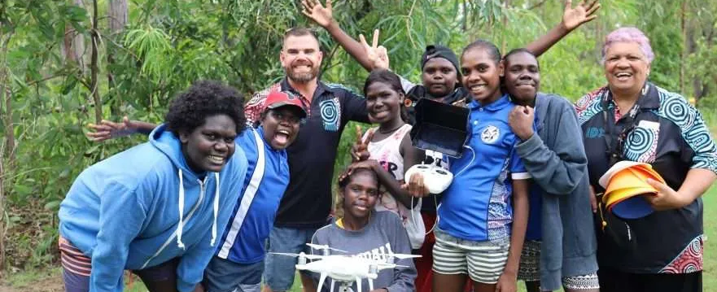
Gullara McInnes is a student in Far North Australia who uses drone technology to preserve cultural heritage of the region.
Gullara recently won the Queensland Aboriginal & Torres Strait Islander 7News Young Achiever Award.
She is passionate about helping young Indigenous people to navigate the intersection of technology and culture.
Drones, once symbols of distant surveillance, are becoming powerful tools in the hands of indigenous communities, empowering them to manage their lands and preserve their cultural heritage in innovative ways.

