Slide 1
Celebrating First Nations Sporting Heros
NAIDOC Week Hall of Fame 2024

Slide 2
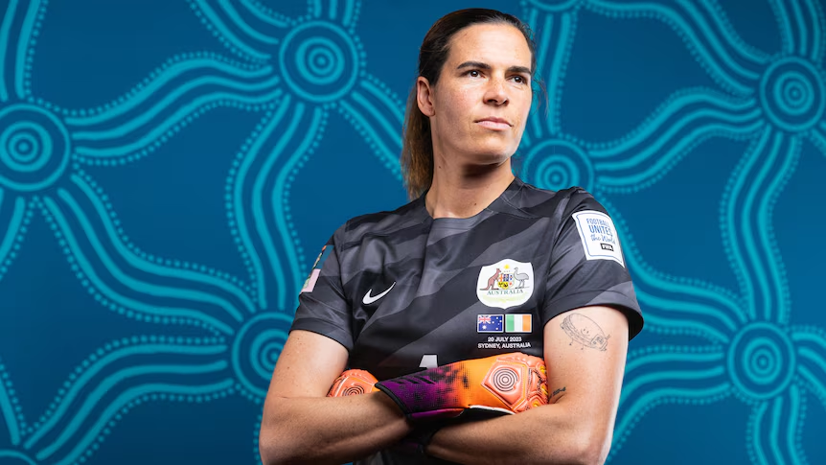
Lydia Williams
Matildas goalkeeper

Slide 3
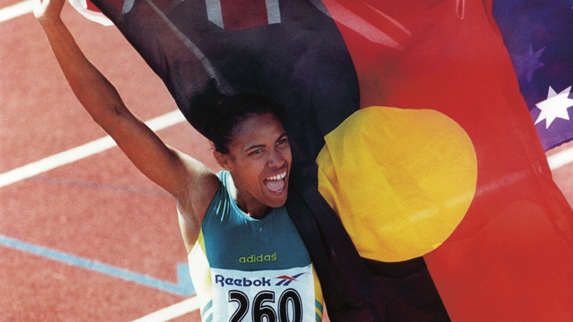
Cathy Freeman
400m Gold Medallist

Slide 4
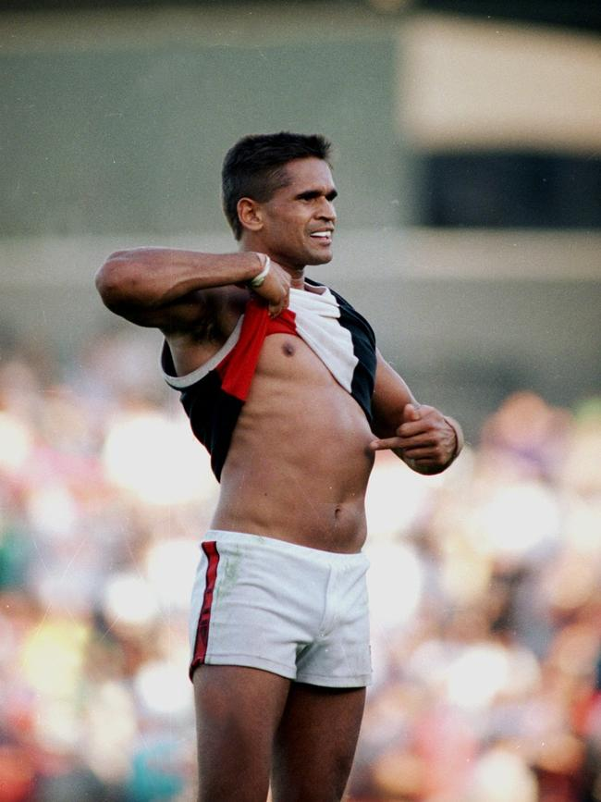
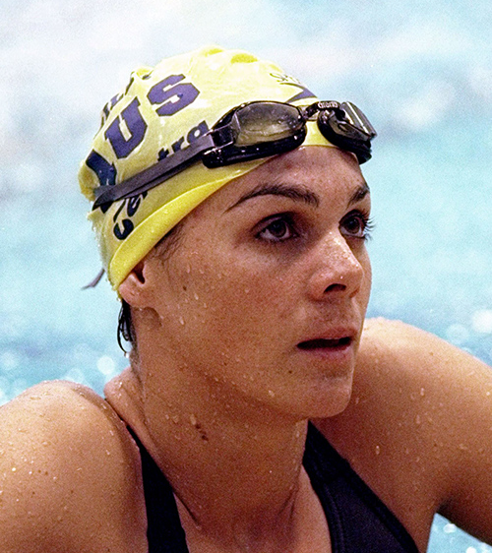
Nicky Winman
Australian Rules changemaker
Sam Riley
Silver and bronze medallist swimmer

Slide 5
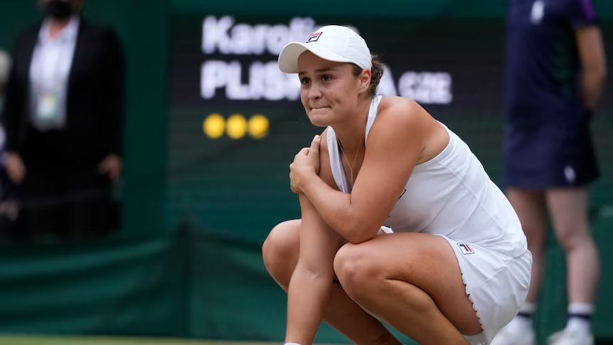
Ash Barty
Former World No.1 Tennis

Slide 6
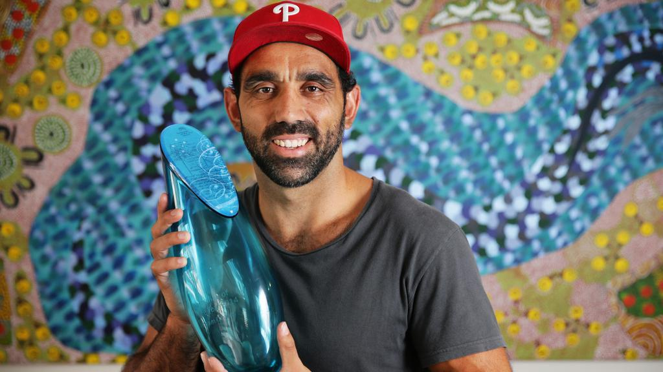
Adam Goods
Australian Rules player and 2014 Australian of the Year

Slide 7
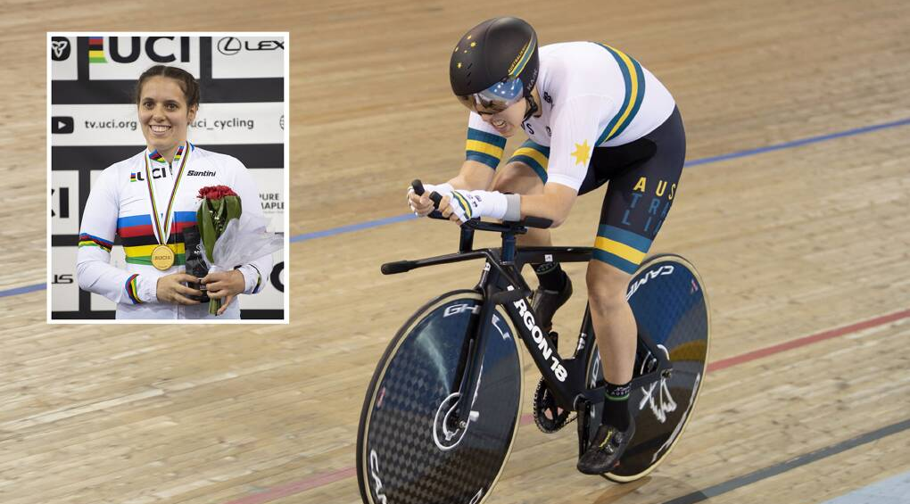
Amanda Reid
Paracycling world champion

Slide 8
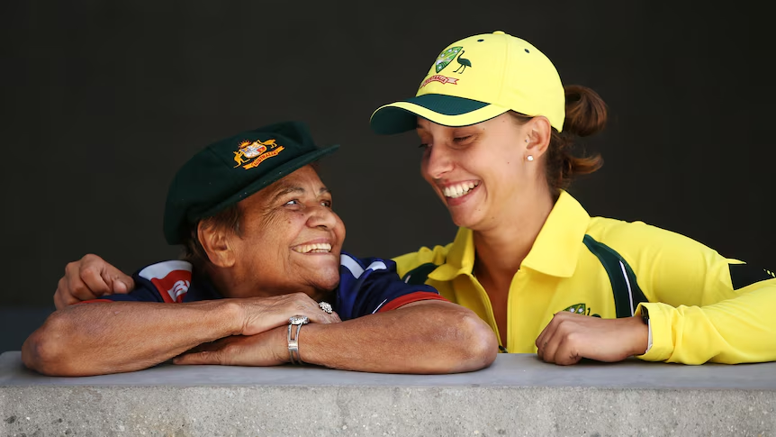
Faith Thomas
First Indigenous women to represent Australia in cricket
Ash Gardner
Australian cricketer and 2022 Belinda Clark Medal winner

Slide 9
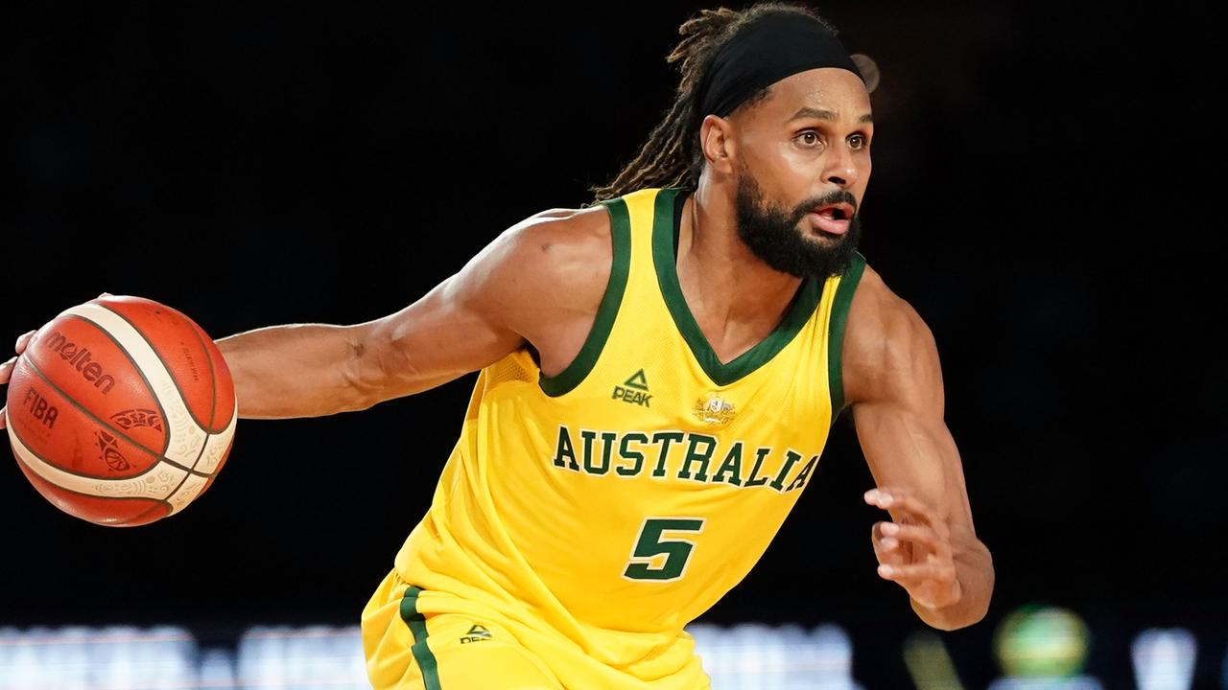
Patty Mills
International basketball star

Slide 10
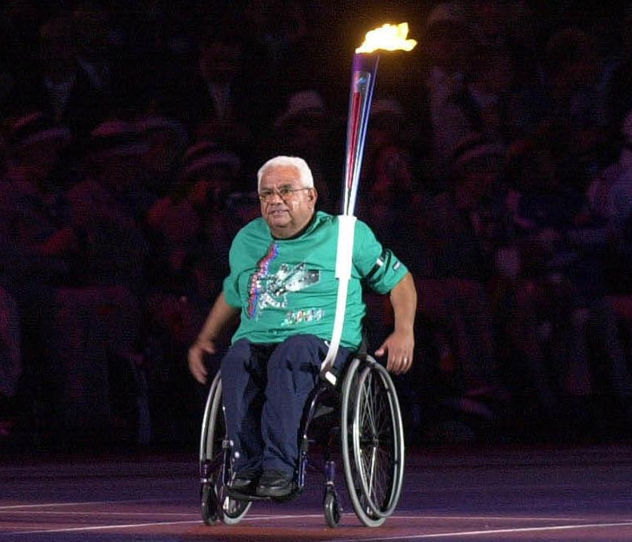
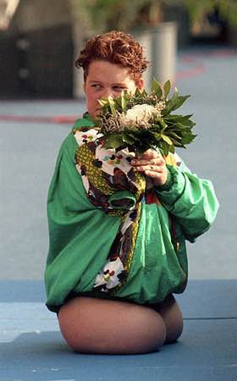
Kevin Coombs
Five-time Basketball Paralympian
Tracey Lee Barrell, Gold medallist Paralympian swimmer

Slide 11
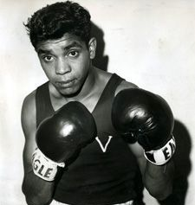
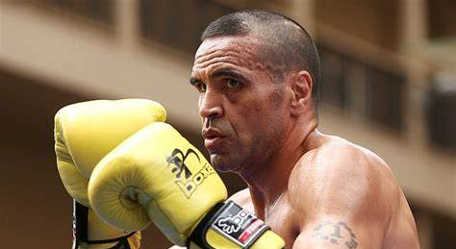
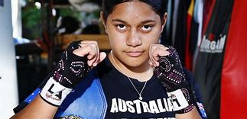
Anthony Mundine, Boxer
Maylifa Peleseuma, Boxer
Lionel Rose, Boxer

Slide 12
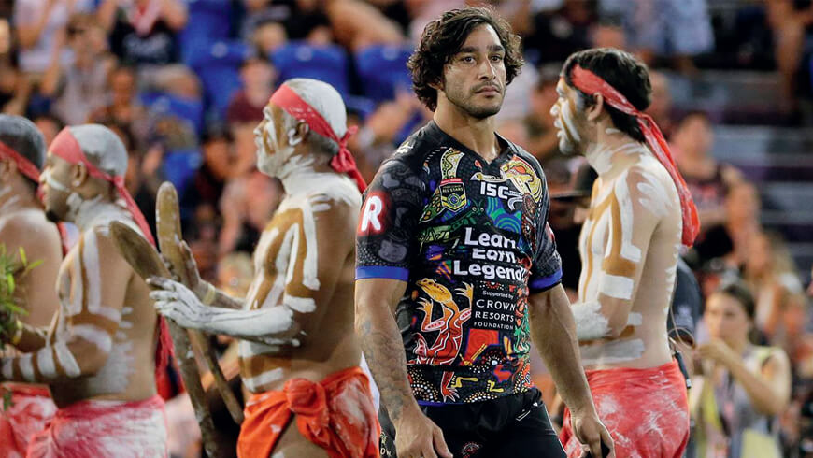
Jonathon Thurston
Rugby League

