Slide 1
Celebrating First Nations Social Change
NAIDOC Week Hall of Fame 2024

Slide 2
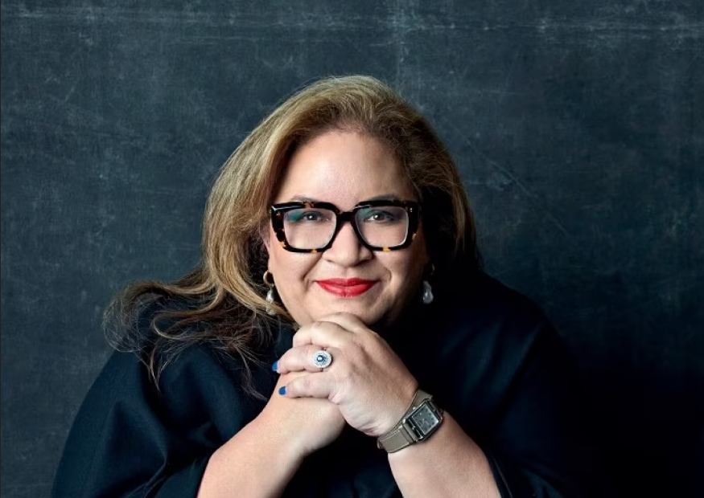
Professor Megan Davis
This Cobble Cobble Indigenous rights expert holds several impressive titles; she is the Pro Vice-Chancellor Indigenous UNSW and a Professor of Law at UNSW, an Acting Commissioner of the NSW Land and Environment Court, a constitutional lawyer and the Uluru Dialogue co-chair.
In 2011, Prof. Davis became the first Indigenous person from Australia elected to the UN Permanent Forum on Indigenous Issues. Six years later, in 2017, she delivered the Uluru Statement from the Heart.

Slide 3
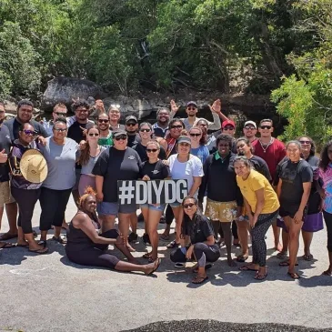
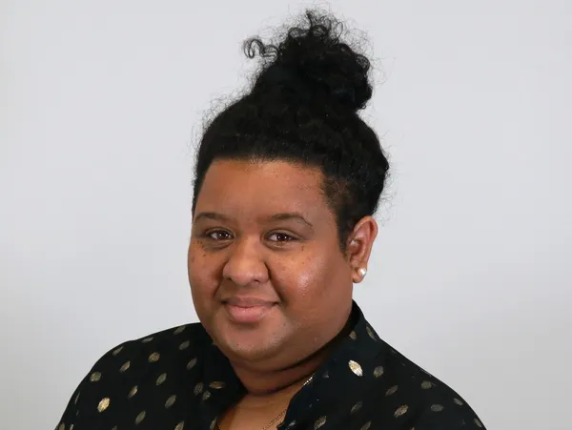
Merrissa Nona
This extraordinary change maker is the Cairns-based CEO of Deadly Inspiring Youth Doing Good (DIYDG), a youth-led non-profit Aboriginal & Torres Strait Islander Corporation founded in 2016 by passionate, empowered citizens to give young people a platform to do good and lead in their communities.
After spending several years as a passionate community leader, Nona won an APAC Insider Award for Most Empowering Youth-Led Organisation CEO this year.

Slide 4
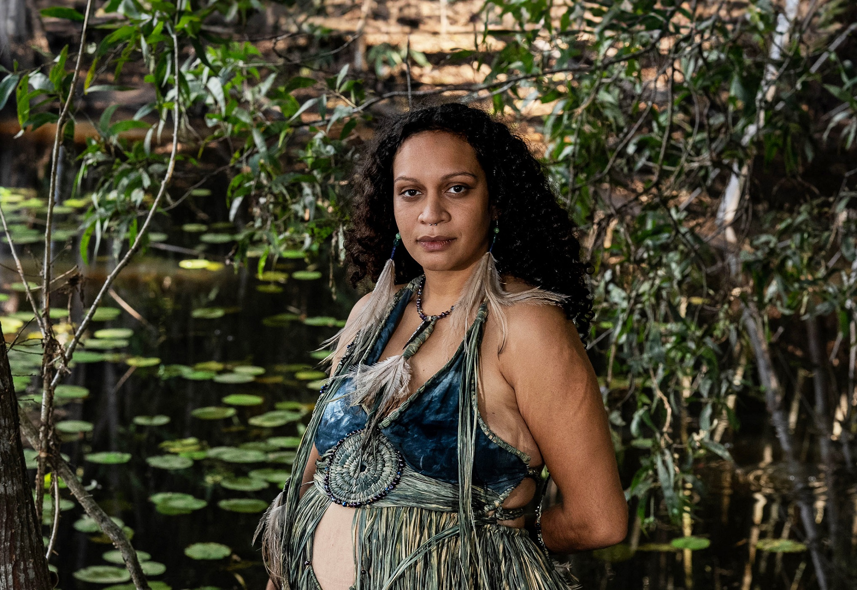
Murrawah Johnson
This inspiring Wirdi woman holds many titles. She is a spokesperson, community organiser and campaigner for the Wangan & Jagalingou Traditional Owners Family Council campaign to stop the Adani Carmichael coal mine proposed on their traditional country.
She was the 2024 Goldman Environmental Prize winner, a prize which recognises individuals for sustained and significant efforts to protect and enhance the natural environment, often at great personal risk.

Slide 5
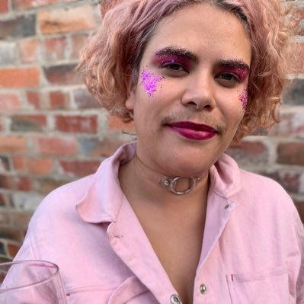
Nayuka Gorrie
This Gunai/Kurnai, Gunditjmara, Wiradjuri and Yorta Yorta writer has been prominently standing up for Indigenous rights and intersectional feminism for years. Not only are they a television comedy writer, they have been a vocal advocate against brutal incarnation in Australia.
Gorrie also joins forces with fellow writer Ashe Davenport to run professional development sessions on defying the sanitised portrayal of parenthood and embracing its often-chaotic realities.

Slide 6
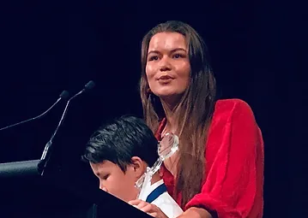
Vanessa Turnbull-Roberts
As a proud Bundjalung Widjabul Wia-bal woman, Turnbull-Roberts has spent years working as a human rights lawyer to highlight the importance of abolishing child protection in the lives of First Nations communities and juvenile detention centres.
She has recently been appointed as the Commissioner for Aboriginal and Torres Strait Islander Children and Young People and is also a Fullbright Scholar.
She has been published in The Guardian, Victorian Women’s Trust, Junkee and Indigenous X while using the power of storytelling, writing, and advocacy to share the injustices committed against First Nations peoples.

Slide 7
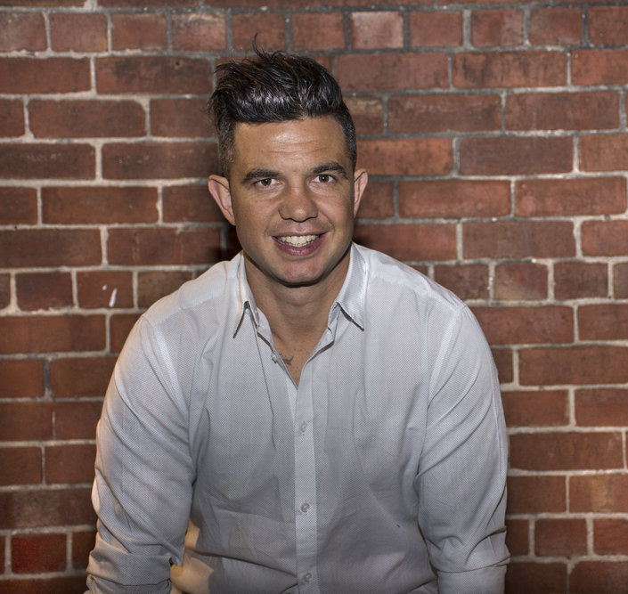
Joe Williams
Joe is a proud Wiradjuri/Wolgalu, First Nations Aboriginal man born in Cowra, raised in Wagga NSW, Australia. Joe played in the National Rugby League for South Sydney Rabbitohs, Penrith Panthers and Canterbury Bulldogs before switching Joe to professional Boxing in 2009. Joe is a 2x WBF World Jnr Welterweight champion and won an WBC Asia Continental Title.
Although forging a successful professional sporting career, Joe battled the majority of his life with suicidal ideation and Bi Polar Disorder. After a suicide attempt in 2012, Joe felt his purpose was to help people who struggle with mental illness. Through customised workshops Joe talks of dealing with adversities, struggles, resilience, addiction, connection, emotional wellbeing & healing trauma in schools, communities, correctional services, sporting clubs and workplaces.

