Slide 1
Celebrating First Nations Music
NAIDOC Week Hall of Fame 2024

Slide 2
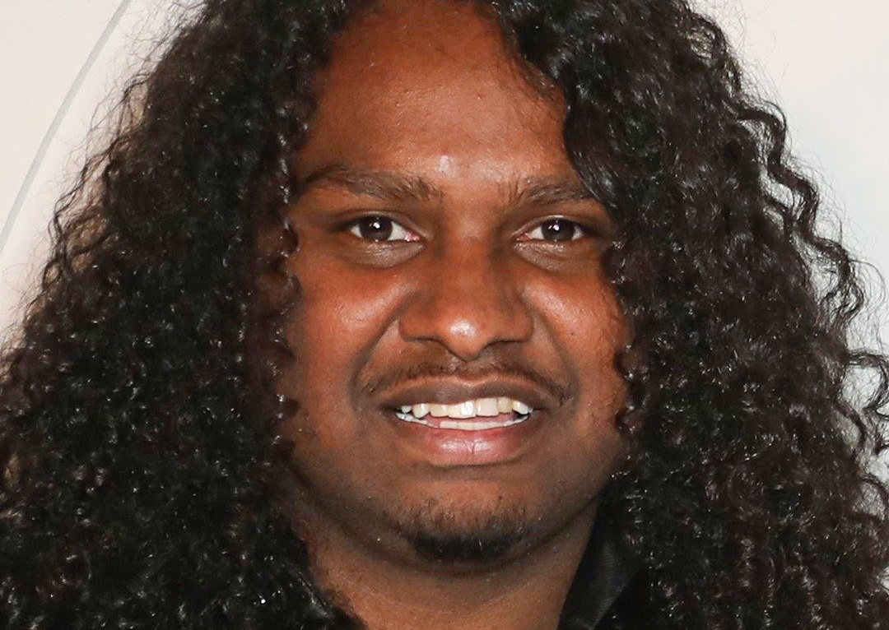
Baker Boy was named Young Australian of the Year in 2019.
He is known for incorporating both English and Yolngu Matha language in his lyrics.
Danzel Baker also goes by Gela and Fresh Prince of Arnhem Land.

Slide 3
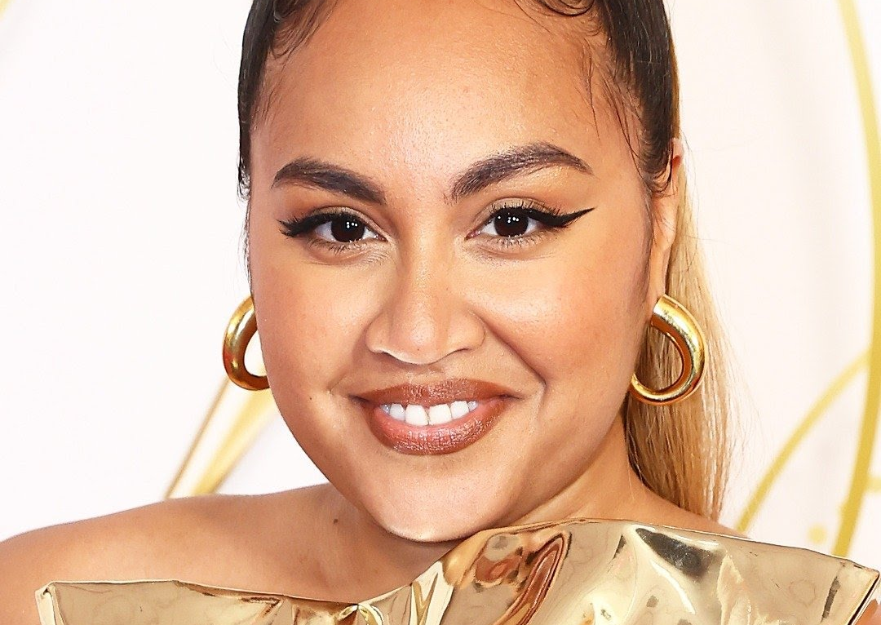
Jessica Mauboy was born in Darwin in 1989 and came to national fame when she appeared in the finals of the fourth season of Australian Idol.
Mauboy’s 2016 album, The Secret Daughter, was the first by an Indigenous Australian to debut in the number-one spot on the ARIA Charts.

Slide 4
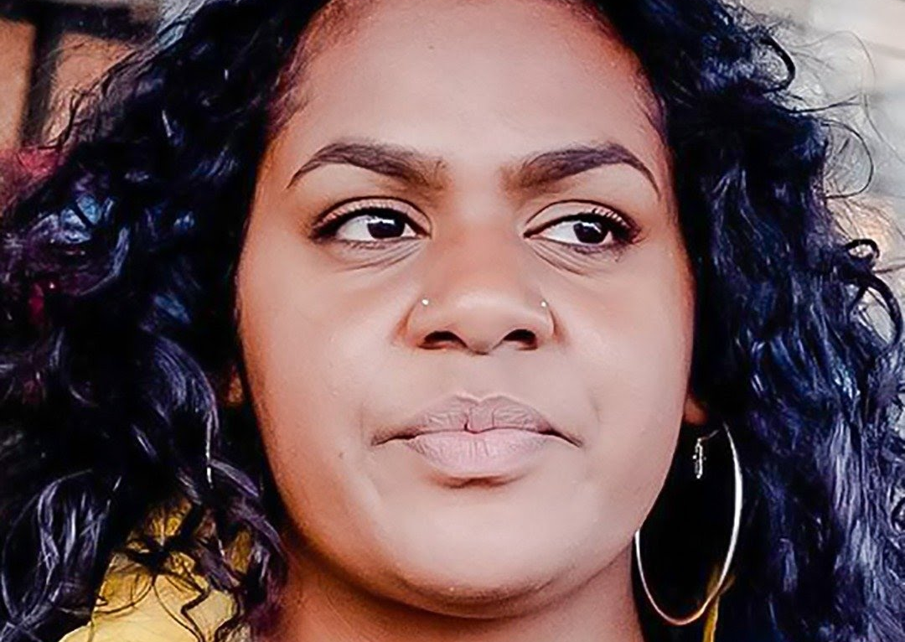
Miiesha (pronounced My-ee-sha) is a proud Anangu/Torres Strait Islander woman from the small Aboriginal community of Woorabinda.
She received the 2020 ARIA for Best Soul / RnB Release in 2020 for her debut collection of songs entitled Nyaaringu.
Nyaaringu means ‘what happened’ in Pitjantjatjara language and Miiesha explores the stories and the strength she inherited from her late Grandmother.

Slide 5
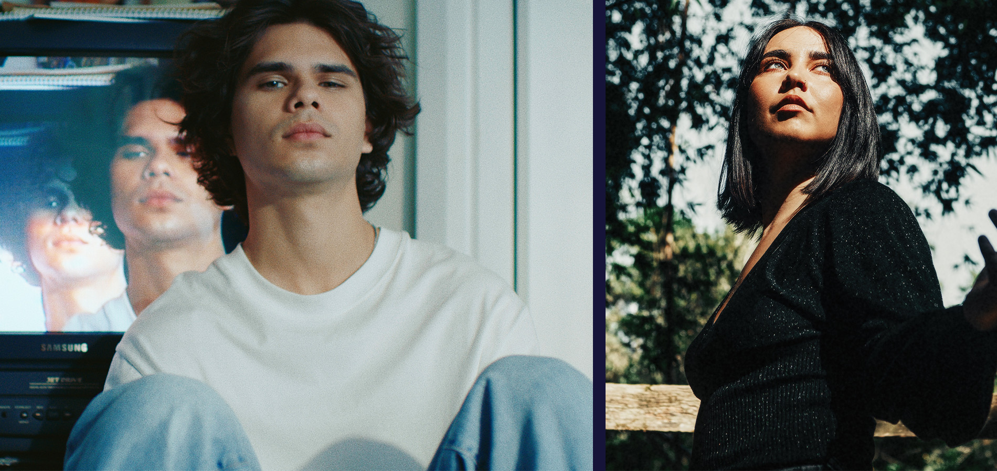
Budjerah and Jem Cassar Daley, R&B Pop / Indie

Slide 6
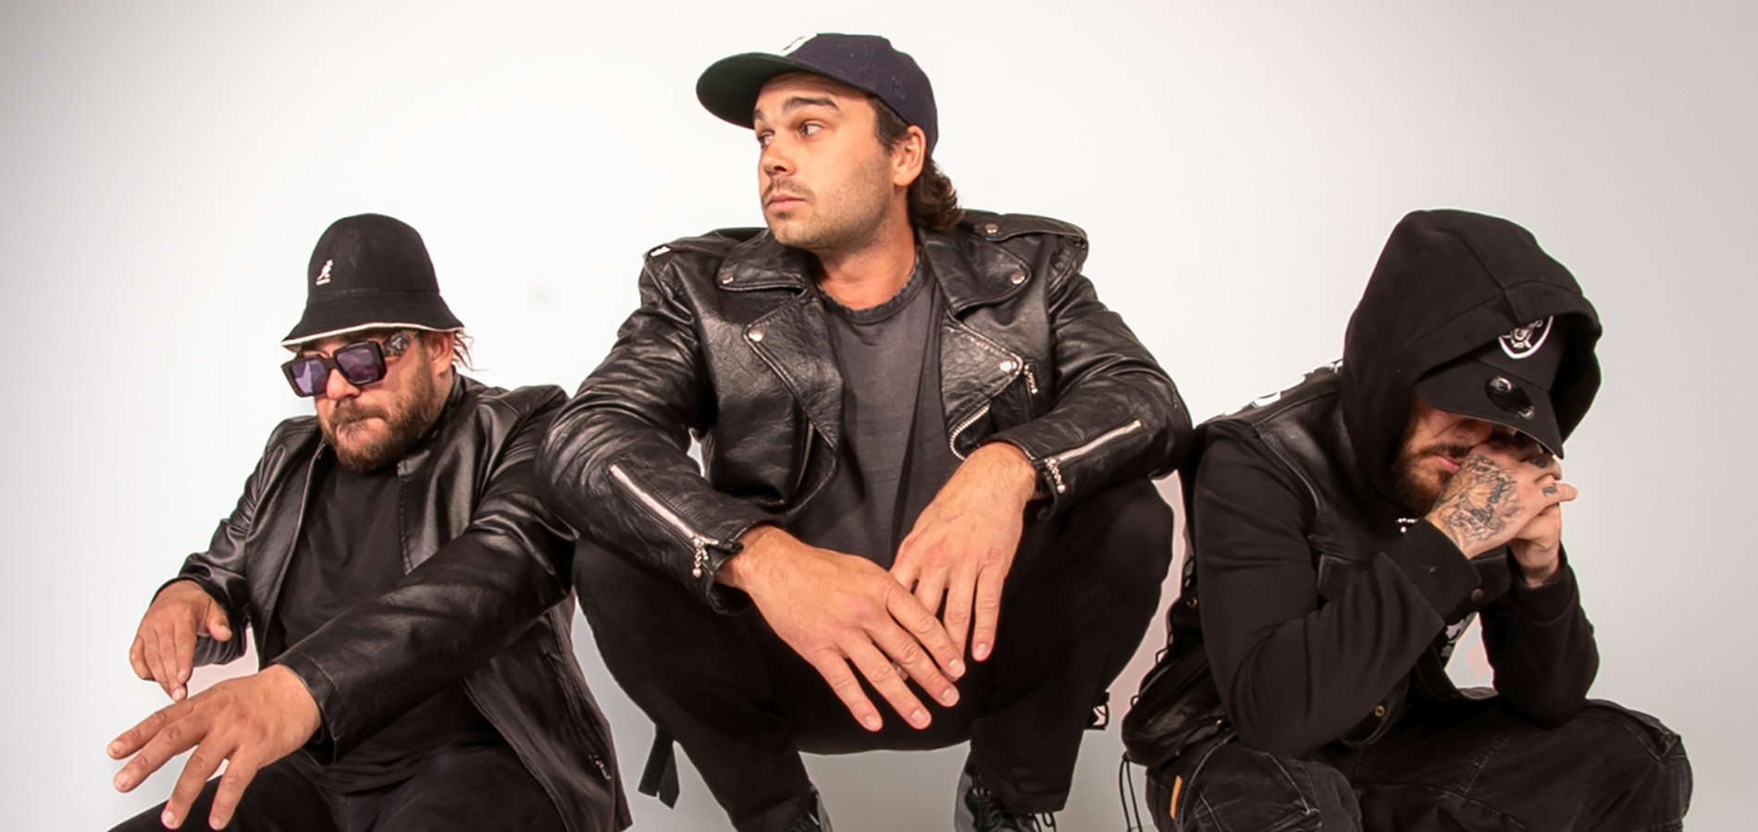
3%, Rap

Slide 7
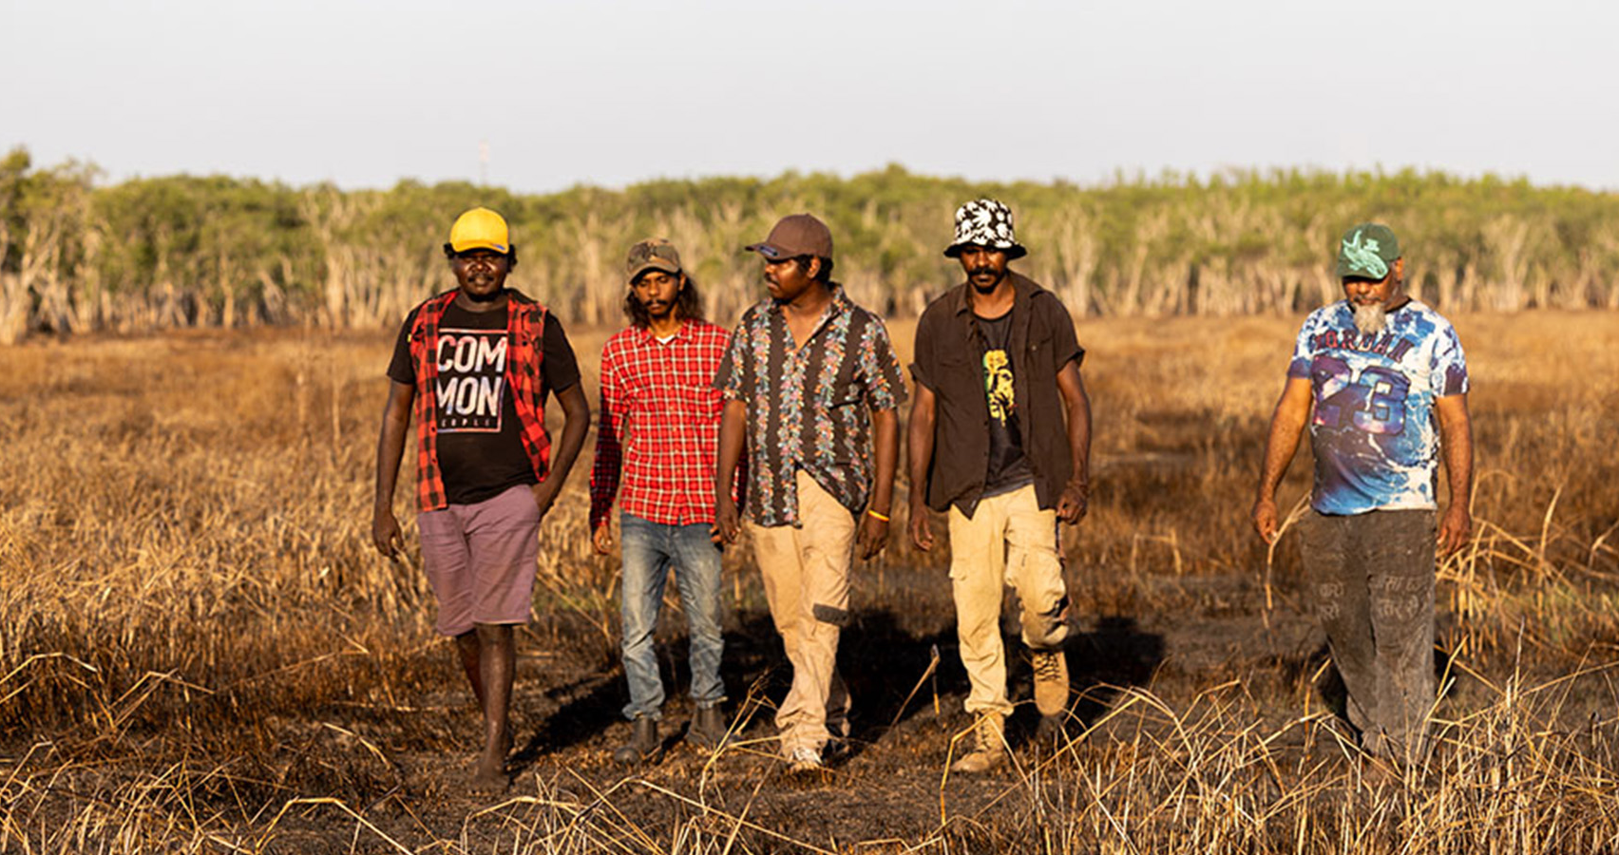
Wildfire Manwurrk, traditional songlines with thrashing rock

Slide 8
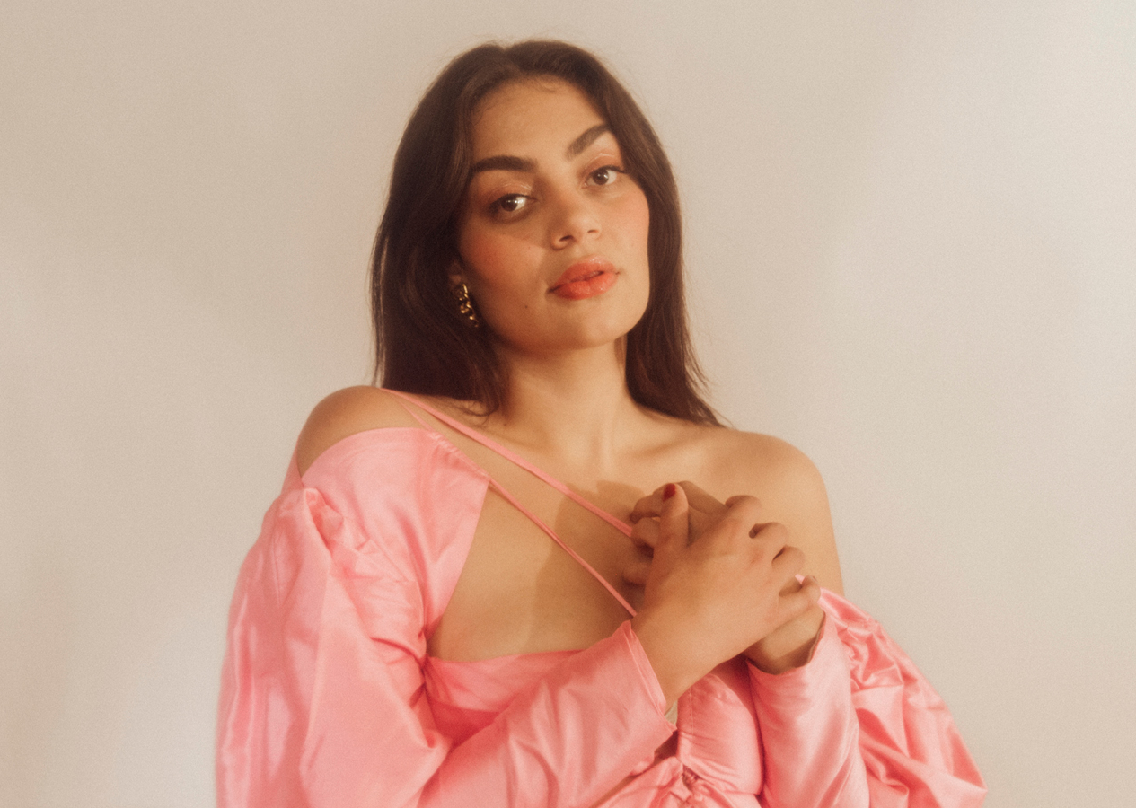
Thelma Plum is an Aboriginal Australian singer, songwriter, guitarist and musician.
Plum won Triple J’s inaugural National Indigenous Unearthed Music award in 2012.
She received 6 nominations at the 2019 ARIA Awards for her debut album, Better in Blak.
Plum is a proud Gamilaraay woman.

Slide 9
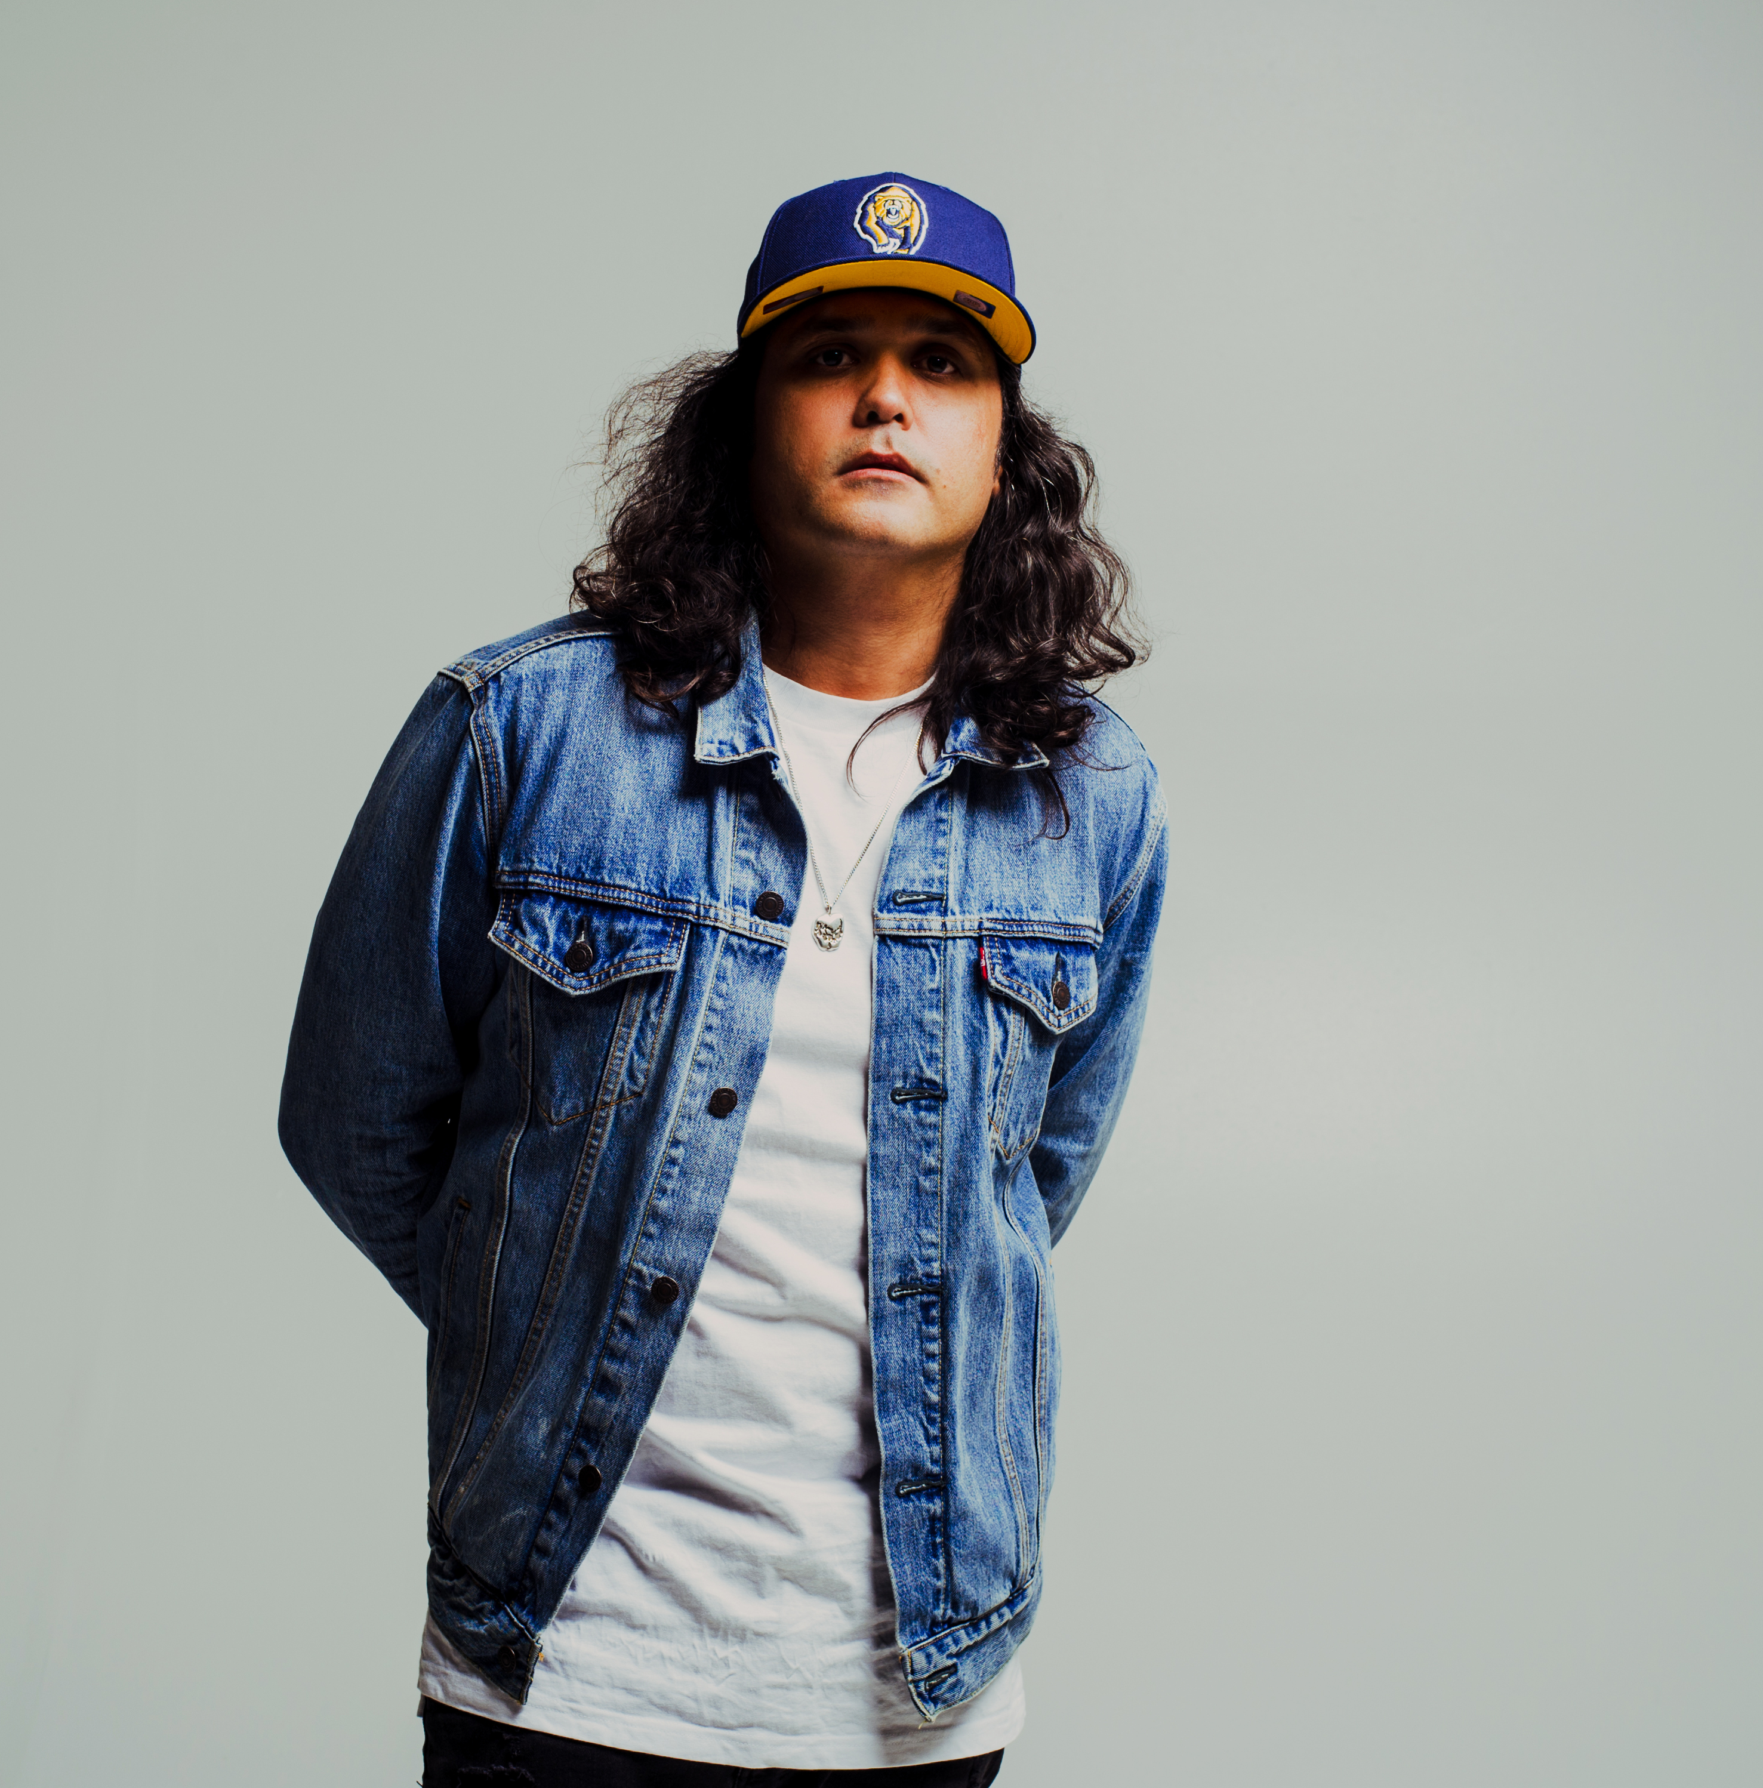
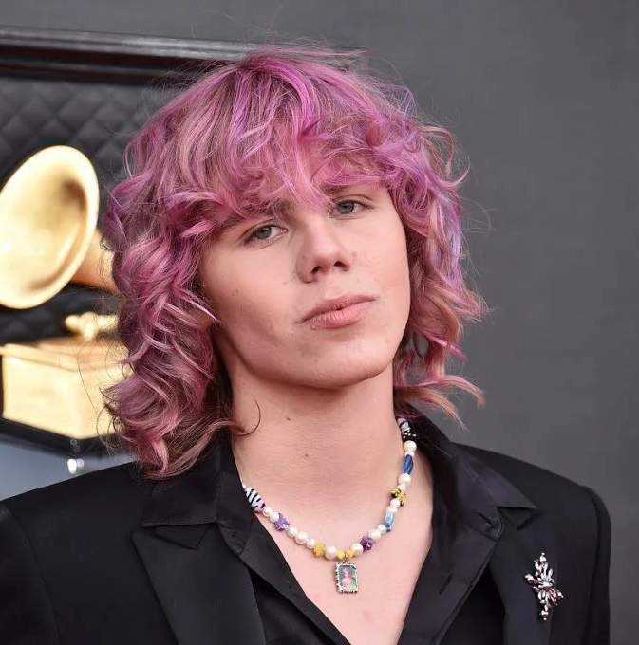
Birdz, the stage name of Bitchulla man Nathan Bird
The Kid Laroi, Rap / Pop

Slide 10
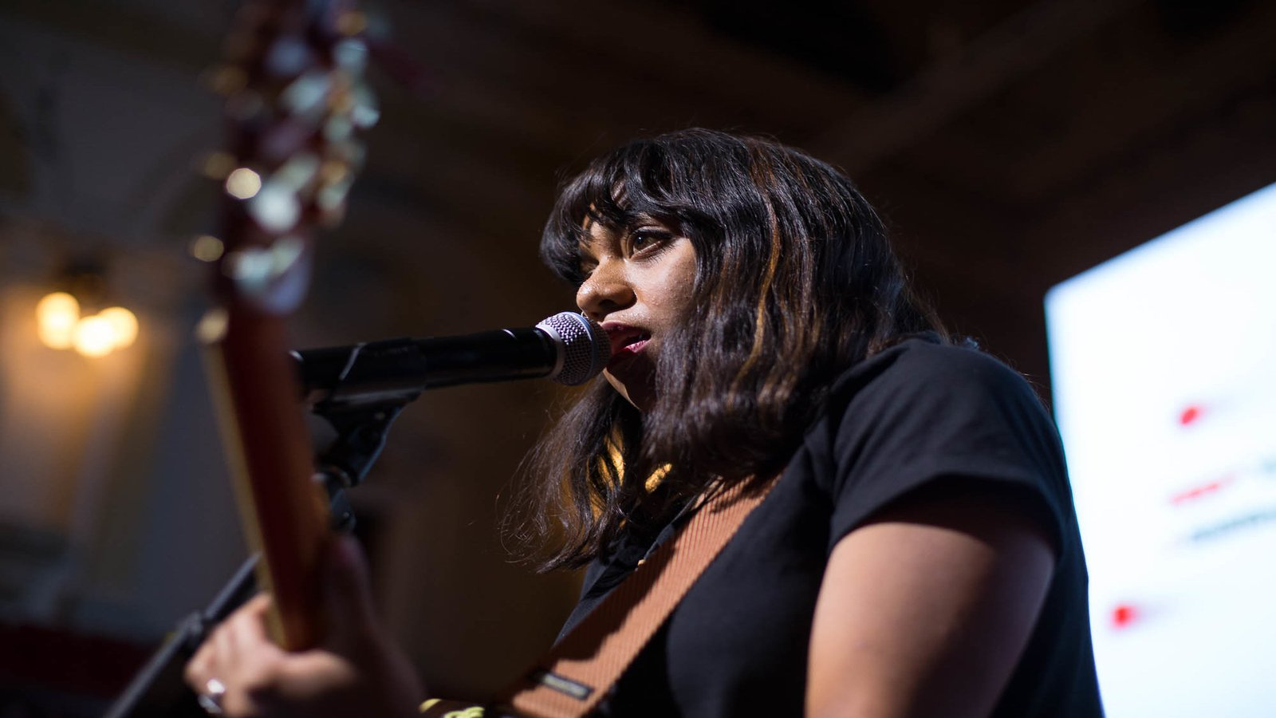
Emily Wurramara is an ARIA nominated singer-songwriter who grew up on the northern Australian island of Groote Eylandt.

Slide 11
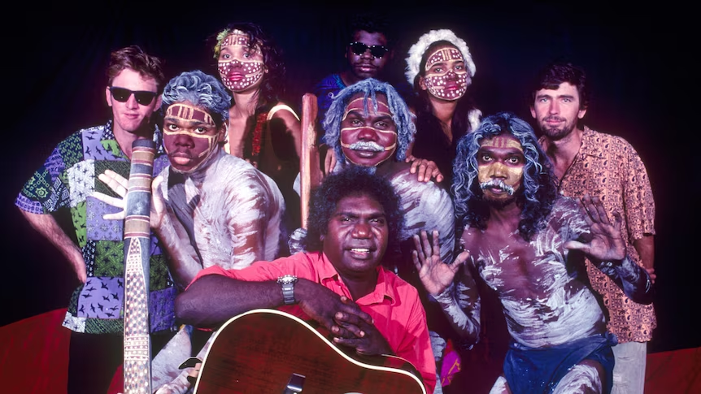
Yothu Yindi have been performing for almost four decades

Slide 12
