Slide 1
Celebrating First Nations Artists
NAIDOC Week Hall of Fame 2024

Slide 2
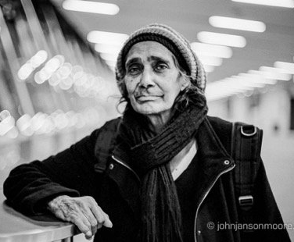

Aunty Barbara McGrady is a leading First Nations photo-journalist. Her photographs form a significant visual record of First Nations identity and contemporary representations of Aboriginal and Torres Strait Islander peoples, particularly the positive contributions they make to culture and community. This is especially true of Aunty Barbara’s photography at sporting events, including games at the NSW Koori Knockout, NRL and AFL, as well as boxing title fights.
https://australian.museum/learn/first-nations/aunty-barb-mcgrady-photos/

Slide 3
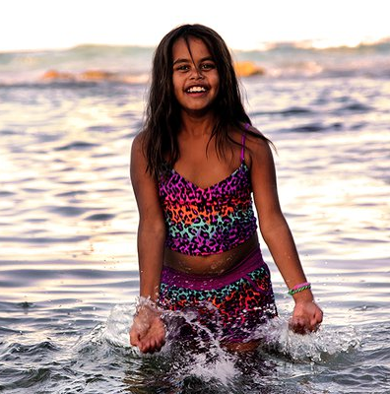
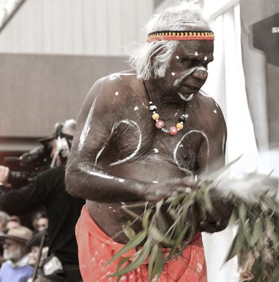
https://australian.museum/learn/first-nations/aunty-barb-mcgrady-photos/

Slide 4
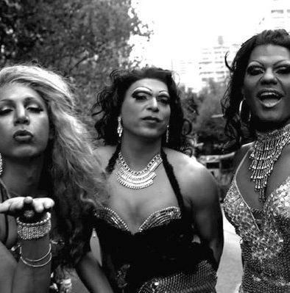
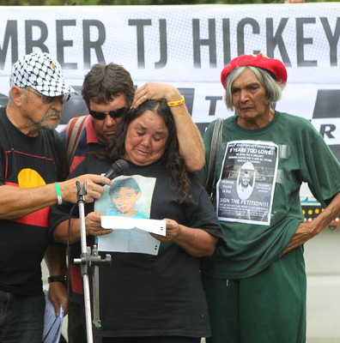

Slide 5
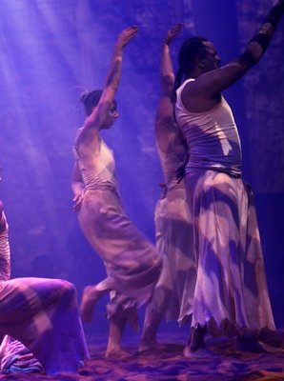
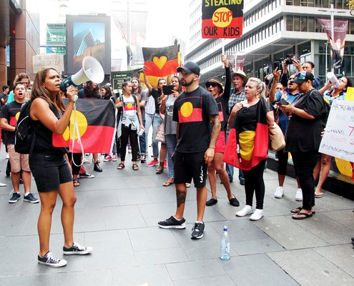

Slide 6
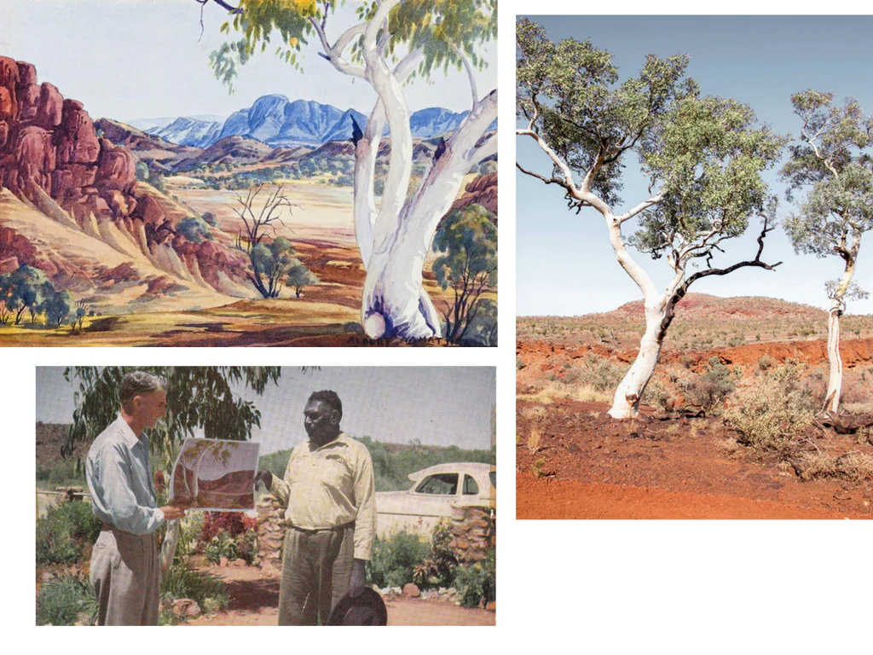
Albert Namatjira was a trailblazing figure in the world of Australian art, renowned for his distinctive style and tireless advocacy.
https://artark.com.au

Slide 7
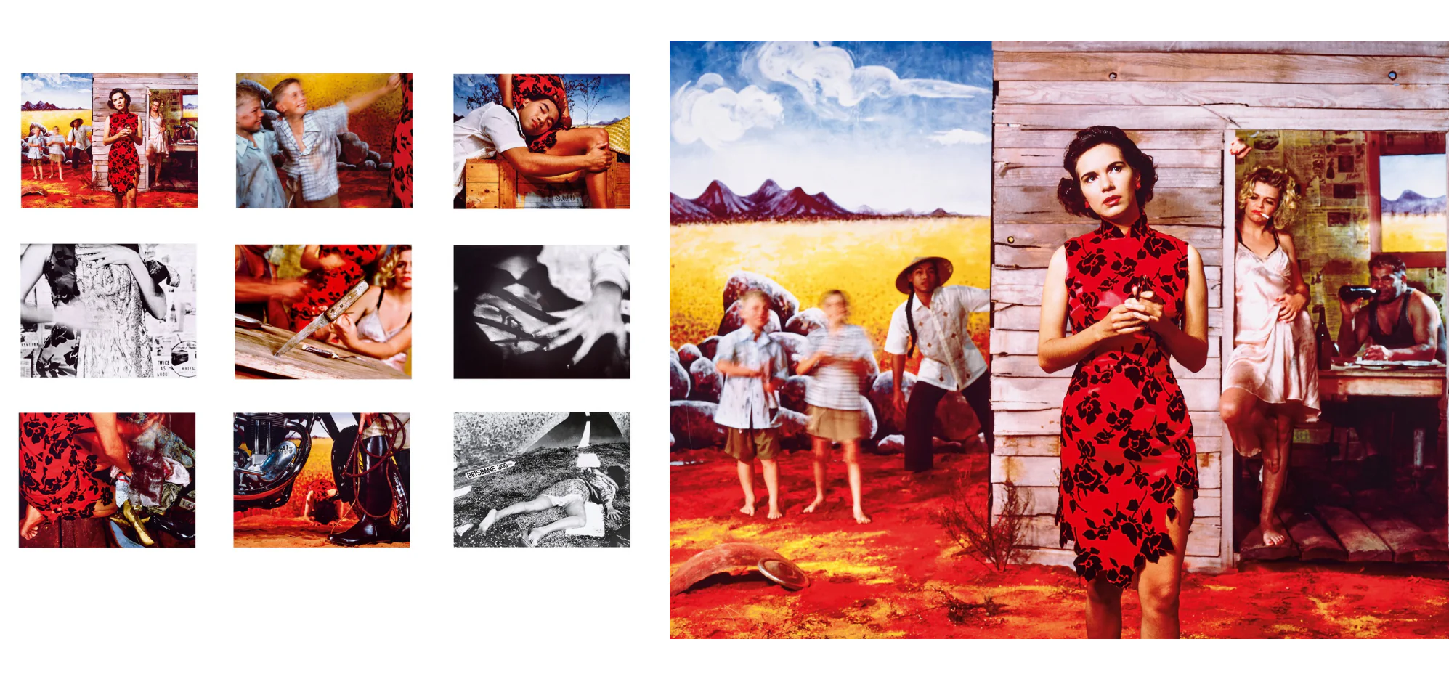
Tracey Moffatt stands as one of Australia's most formidable and insightful contemporary artists with a body of work that deftly navigates the complexities of identity, history, and the nuanced layers of human connection.
https://artark.com.au

Slide 8
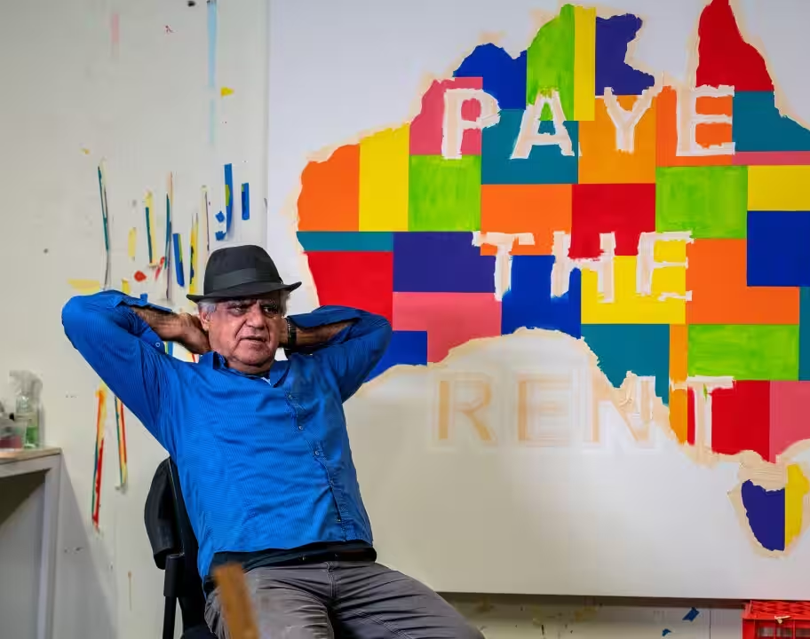
Richard Bell, born in 1953 in the small town of Charleville, Queensland, has carved a niche for himself as one of Australia's most provocative and insightful contemporary artists. His journey is marked by a bold confrontation with the art establishment and an unwavering commitment to Indigenous rights.
https://www.sbs.com.au/nitv
https://artark.com.au/blogs/news/richard-bell

Slide 9
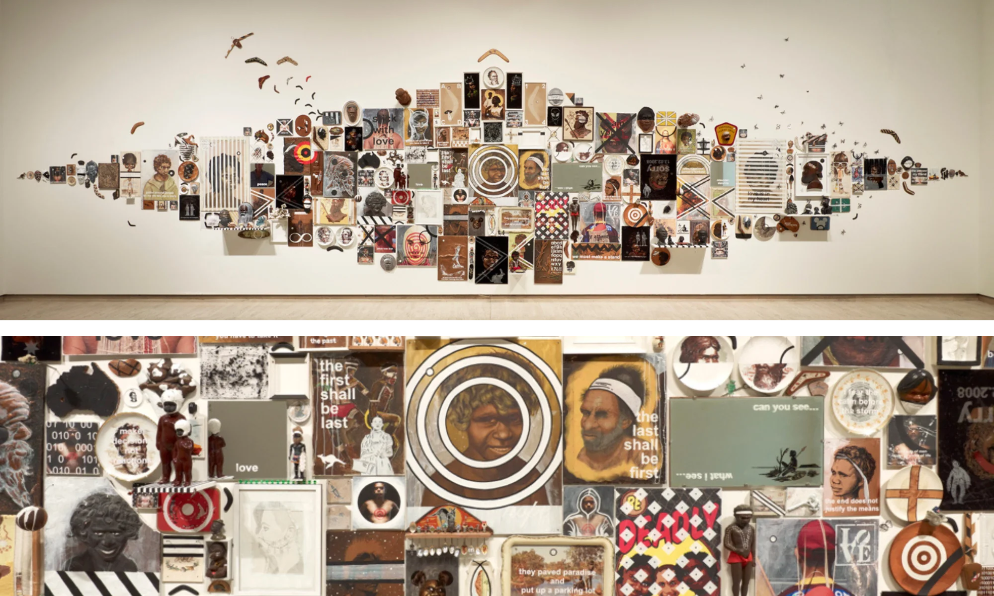
Projecting our future, Tony Albert, 2013
https://artark.com.au/blogs/news/tony-albert

Slide 10
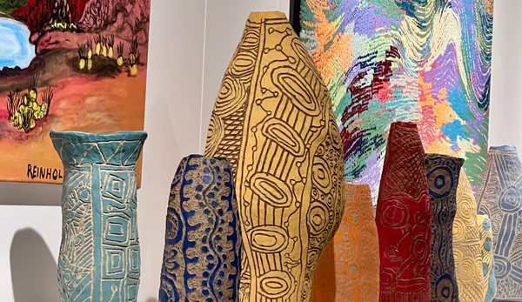
https://www.aboriginalcontemporary.com.au/

Slide 11
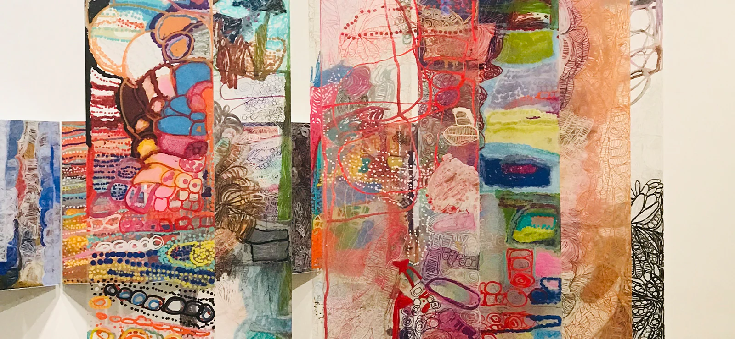
https://www.aboriginalcontemporary.com.au/

Slide 12
