Slide 1


Keeping connected
Thank you for being patient while everyone is entering the meeting
Notes:
Welcome everyone
Introduce the facilitator
Thanks for taking time away from your busy roles to meet with us today.
We recognise this is precious time having you all together at the same time.

Slide 2


Acknowledgement of Country
‘JOY’ - QArt’s Mya Wilson, Wurundjeri artist
“This idea for this painting was conceived during the Covid pandemic. I wanted to express the disharmony and the multiple challenges that people faced during this time. This is a contrast to the Dreamtime when all living creatures lived harmoniously and sustainably on the land and in the sea. I have used modern bright pastel colours to lighten the mood. The intention is to create a feeling of happiness, growth and hope.”

Slide 3
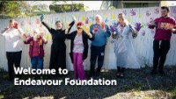
Welcome

Slide 4
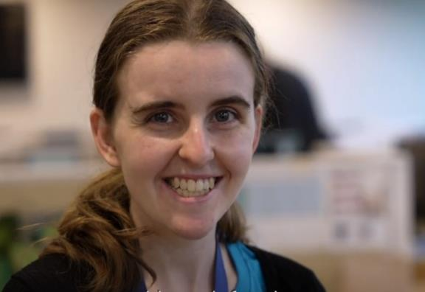
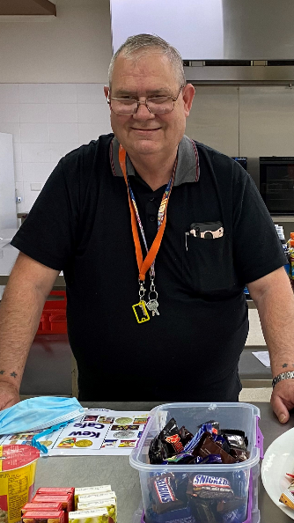
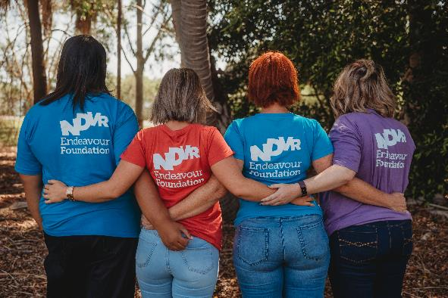
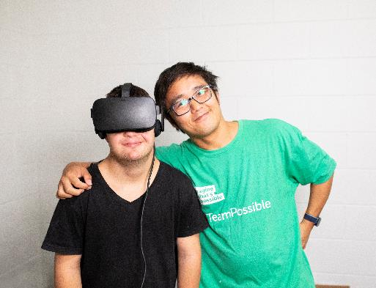
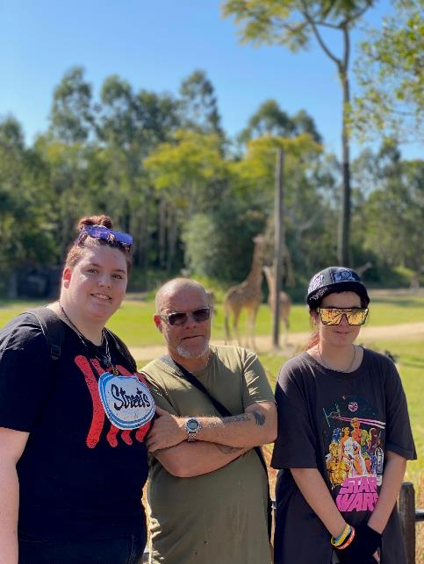
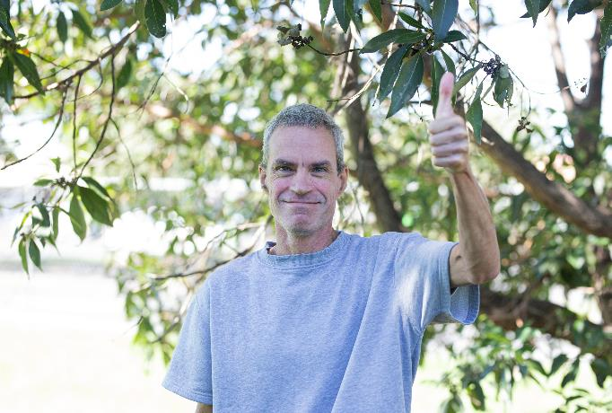
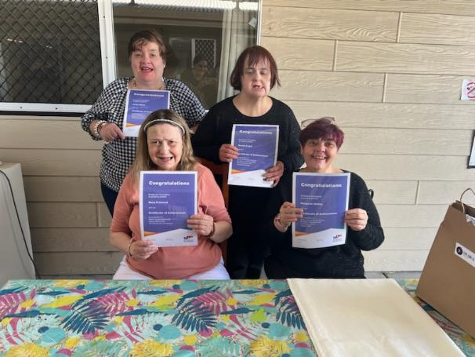
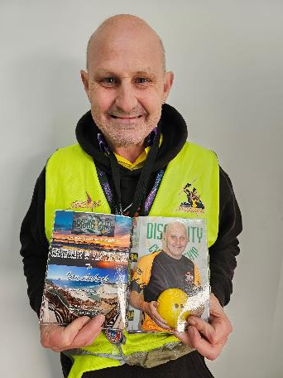
Why we are here
Notes:
Welcome (why are we here)
Team Connect is about uniting us – the ESS survey said
there was not enough information on progress
It’s a dedicated time (twice a year) to
information is filtered down
Disconnect between frontline and supporting functions.
limited opportunities for 2-way communication.
We want to hear from as many people as possible
Today we are focusing on topics important to you!

Slide 5
Agenda
Speaker | Topic
David Swain Chief Executive Officer | 2023 EES results Challenge
Leanne Rutherford Executive General Manager – Home and Community | Home and Community Questions
Tom Mangan Executive General Manager – Community Solutions | Community Solutions Questions
Eric Teed Executive General Manager – Work | Future of work Questions
Shannon Foley Chief People Officer | People and Wellbeing Questions
All Executive Leadership Team including Kirrily Boulton Chief of Staff & Corp Affairs Darryn Hammond Executive General Manager - Legal and Governance David Blower Chief Financial Officer | Ask us anything
Notes:
Today, some members of the executive team will share some brief presentations and you can ask questions about their presentations afterwards.
Then all members of the executive team will be available for a general question time for about 30 minutes before we wrap up.
Introduce all members of ELT who are online.
Housekeeping
During the session, we will be asking you some questions to help us get a sense of how everyone is feeling.
You will need to have your mobile phone on hand. We will give you some more instructions in a moment.

Slide 6

Tell me something I don’t know
Share a good news story
Notes:
Ask to use reactions or chat
Invite people to come off mute and share a story

Slide 7
Employee Engagement
Pulse Survey (April 2023)
What’s good…
We’re proud to work here – 79% (+3)
Our managers are great role models – 75% (-)
We’d recommend our organisation as a great place to work – 72% (+3)
Our organisation really allows us to make a positive difference – 70% (+4)
The overall Engagement result has increased 2-points from October to 65%
Notes:
The Engagement result for April 2023 was 65%, which is an incremental increase of 2 points.
Engagement is a measure of our connection to out workplace. This is typically measured through what we ‘say’ about our organization, whether we ‘strive’ or the effort we put in for our organisation, and whether we intend to ‘stay’ with our organization.
The areas we are doing well in are:
‘We’re proud to work here’ +3 points.
Recommend org as a good place to work +3
Allows us to make positive difference +4
These are good results and the increase in the results means we’re heading in the right direction.
But we can do better.
We know that high engagement in an organisation has many benefits; it creates a better work culture, it reduces staff turnover, it increases productivity, it builds better work and customer relationships, and impacts a company’s financial sustainability. Which is why it’s important to us, and why we continue to talk about it.

Slide 8
Employee Engagement Pulse Survey (April 2023)
What’s
not so good
but improving…
Our leaders have communicated a vision that motives us – 59% (+3)
Our senior leaders demonstrate that people are important to our company success – 57% (+4)
At our organisation there is open and honest 2 way communication – 62% (+5)
Our company values match our culture – 67% (+8)
Notes:
These are the questions that have been identified as the most important to our people (and will increase engagement if they improve). These are also the areas where we have been putting in the most effort (based on previous survey feedback) and we can see that there has been an improvement.
Company values don’t match culture - 67% but +8 increase.
Leaders communicate a vision that motivates us – 59% but +3 increase
Senior leaders demonstrate that people are important to our success – 57% but +4 increase.
Open & honest two-way communication – 62% but +5 increase.
It’s great that we’re seeing an improvement in these areas – it means the changes we’ve made are having an impact. But we also know we need to keep improving in these areas and your feedback in the engagement surveys helps us to improve, so please keep completing your surveys.
Our next survey in due in October – this is a full survey, so it’s a little longer. We do a full survey every 2 years and a pulse (shorter version) every 6 months to see how we’re tracking.

Slide 9

My challenge:
A vision that
motivates you…

Slide 10

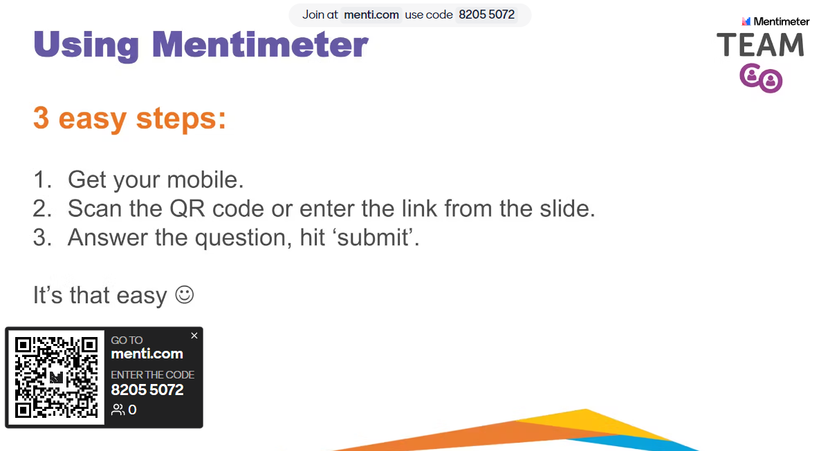
Using Mentimeter
3 easy steps:
Get your mobile.
Scan the QR code or enter the link from the slide.
Answer the question, hit ‘submit’.
It’s that easy ☺

Slide 11
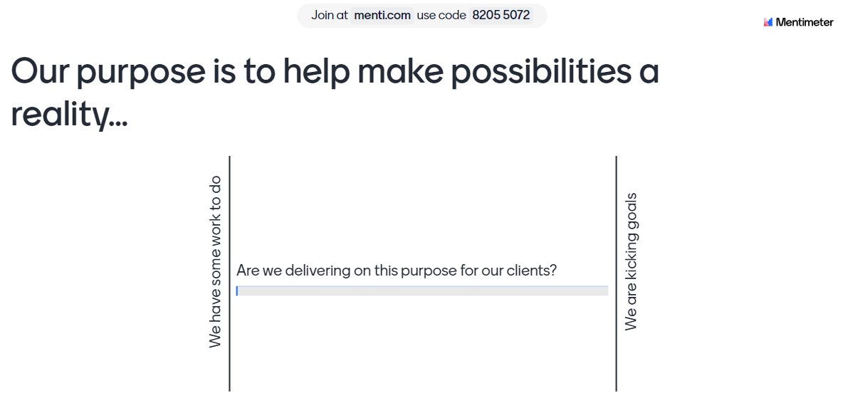
LIVE POLL
Our purpose is to help make possibilities a reality….
…are you delivering on this purpose for your clients?
Notes:
Scale – We have some work to do > We are kicking goals

Slide 12
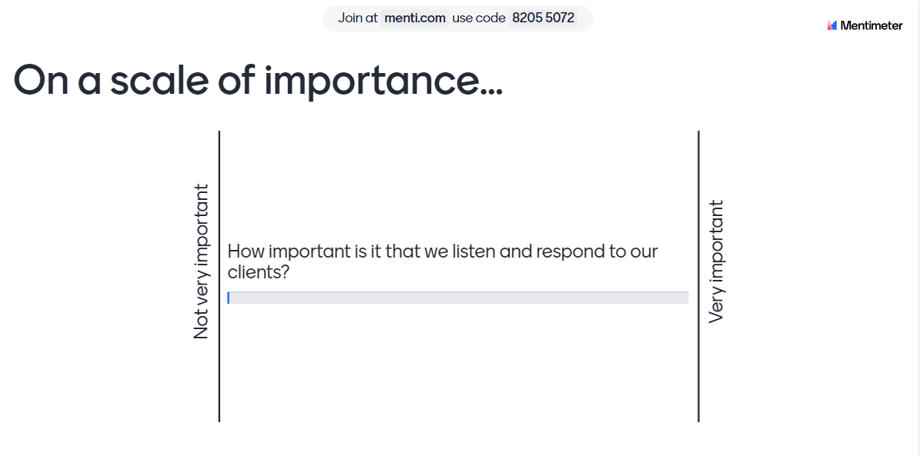
LIVE POLL
On a scale of importance….
…how important is it that we listen and respond to our clients?
Notes:
Scale – Not very important > very important

Slide 13
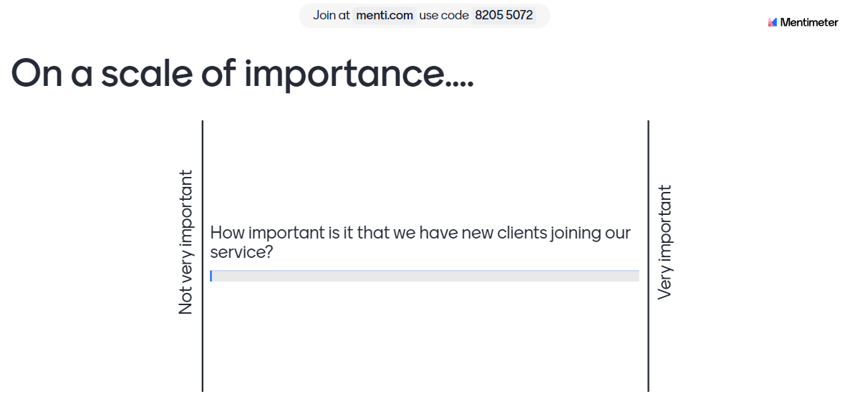
LIVE POLL
On a scale of importance….
… how important is it that we have new clients joining our service?
Notes:
Scale – Not very important > very important

Slide 14
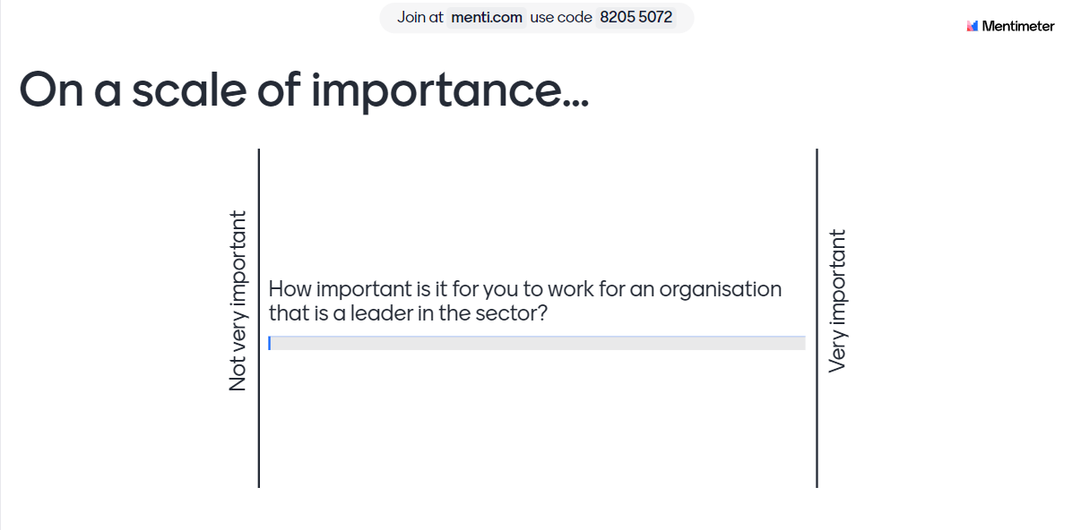
LIVE POLL
On a scale of importance….
… how important is it for you to work for an organisation that is a leader in the sector?
Notes:
Scale – Not very important > Very important
** After this slide, we can ask people to put their phones away, there are no further questions **

Slide 15

Growing our impact
In 2027…
Leader in the disability sector in Australia.
Positive impact in the lives of people we support.
Largest employer of people living with a disability.
Largest portfolio of disability specific housing.
Programs and services for all stages of life.
      We make possibilities a reality
Notes:
In 2027…
Endeavour Foundation leads the disability sector in Australia. We care less about comparisons, and more about the difference we make and the impact we have for people living with a disability.
We are the largest employer of people with a disability in the country. We train a workforce of job-ready people, helping them build a career or gain skills and confidence in their chosen jobs.
We partner with national companies, helping them embrace inclusion, making Australia more inclusive.
We operate the country’s largest portfolio of disability specific housing, spread across the Eastern seaboard with a significant footprint in NSW and Victoria.
We offer programs and services for all stages of life. We lead the sector with measuring the impact of the outcomes for the people we support.
We deliver leading research into employment barriers and abuse prevention. We are a leading advocate and campaign partner, with the voice of people we support prevalent in our organisation. Policy makers, funders and regulators seek our advice.
We empower our employees to reach their potential. They feel valued and supported and love working here. We are seen as the employer of choice in our sector, known for our reconciliation, inclusion and diversity.
We are recognised leaders of philanthropic intent. We have a strong relationship with our supporters which continues to grow.
We are among the top five disability service providers in the country with diverse service and income streams. We continue to set the industry standard with impact measures for personal goal achievement, safeguarding, employment outcomes, economic contribution, and environmental impact.
We make possibilities a reality

Slide 16

Ring the bell moments
40 internal traineeships
Defence Assistance Program (DAP) - steps to mainstream employment
Agency staffing reduction
First community clients in NSW and VIC
Information Security Management System Audit outcomes
Draft constitution
FY23 financial performance
Budget challenges
  Best year for fundraising!
Financial targets FY24:
  Clear targets, metrics and monitoring
External environment
Disability Royal Commission: reflections
Supported Employment
  Futures Forum / wages
Political Engagement
Disability Workforce

Slide 17

Questions?

Slide 18

Home and Community
Leanne Rutherford

Slide 19
Home and Community
1500 employees
525 clients in Home
1220 clients in Community
161 properties in Home (123 we own)
32 Learning & Lifestyle hubs

Slide 20





Our WHY - client need
Grow our Impact
Supporting people to live their best lives
Safe
Consistent
Engaged

Slide 21



FY23 achievements and progress
SAFE
VR and Thrive
Reporting culture
New Community services - NSW and VIC
CONSISTENT
Agency usage below 6%
Decentralised Rostering
Roster Optimisation
Staff, stakeholder, family engagement
Service redesign; client growth
National Injury Insurance Svc Qld provider
ENGAGED
Notes:
SAFE
Community Program approach
Embed VR and Thrive into our programs
Reporting Culture – focus on improvement
NSW/VIC Community growth – commencement of COMAC/IHS in June 2023
CONSISTENT
Reduce Agency Usage – 10.37% in March to 5.68% in August
Roster Optimisation – NQ and Gympie final regions to complete
De-centralisation of rostering operating model
ENGAGED
Reduce Agency Usage – 10.37% in March to 5.68% in August
Roster Optimisation – NQ and Gympie final regions to complete
De-centralisation of rostering operating model

Slide 22
FY24 priorities
Consistent Practice approach, Outcome Measurement
Grow Community services in NSW and VIC
Individual Support Plans, Health Check, Incident Management focus
SAFE
CONSISTENT
Agency usage: ZERO by October 2023
Frontline leadership focus
Projects: On-Call design, Transport
Support NDIS Choice & Control project
ENGAGED
Ongoing stakeholder and family engagement
Defined GROWTH goals and targets
New staff - onboarding and training
Property partnerships
Notes:
SAFE
Consistent Practice Approach (Practice Framework development)
Home & Community Program Models
Outcome Measurement Framework development
NSW/VIC Community growth project
ISP / Health Check / Incident management focus
CONSISTENT
Reduce Agency Usage to 0% by Oct 2023
Roster Optimisation Finalisation: NQ and Gympie final regions to complete
Frontline Leadership Review
Oncall redesign
Transport Project
Supporting Choice & Control: NDIS Support Funding Management Review / Project
ENGAGED
Stakeholder / Family Engagement ongoing focus
GROWTH Strategy
Induction and Onboarding of new staff
Property Partnerships

Slide 23
Questions?

Slide 24
Community Solutions
Tom Mangan

Slide 25

Who is Community Solutions?
Then
Community Solutions
New Services and Mergers
Merge with Endeavour Foundation
Now
Community Solutions Division
17 Services
10,000 Clients
3 Portfolios
500 Staff
30 Sites
Notes:
Then
Established 27 years ago around the kitchen table of the founder to delivery community based services om the Sunshine Coast
Grew over the years to be a major provider through taking on many new services and finding as well as merging with another 8 different like minded not for profits in Queensland and Victoria
We became part of Endeavour Foundation in 2014 after a successful merger
Now
Along with Work, and Home and Community we are the third service delivery division of Endeavour
We have a large caseload of over 10,000 clients who we support across 17 different services
As a division we employ over 500 team members
We have over 20 sites stretched from Cairns in the North to Frankston in SE Melbourne

Slide 26



What do we do?
Employment
8000 Clients
200 Apprentices and Trainees
Education and Training
475 Students
2300 Clients
40 Endeavour Foundation Trainees
Youth Supports
Vocational Training
Specialist Services
130 Practitioners
Notes:
We have a number of initiatives in play at the moment to grow our services and to support Endeavour Foundation
Provide more and more new staff to Endeavour Foundation – Whether that be trainees, or staff on our sites or at the Service Centre. With 8000 people on our caseload we have many high quality candidates who would love to be part of our team
Expand our NDIS Specialist Services into Sydney and other regions We have been very successful growing in Queensland and Victoria and we have begun taking that success to NSW
Many of our allied services have applications outside of the NDIS so we have begun growing and developing our non-NDIS revenue streams
You may have heard of Disability Employment Services or DES. Its one of the major contracts we deliver. Next year we will be drawing on our 75 years of history and knowledge to tender to become a nationwide Intellectual Disability Specialist provider.
Our training services are Melbourne based and we plan to expand into Queensland and NSW with a focus on disability related training for our clients our staff and people who work in our sector

Slide 27

Build Endeavour Workforce
Expand and Grow
Specialist Disability Employment Services
New Allied Health
What’s next?
Notes:
Employment
We work with people to help them overcome barriers to employment, find them a job and help them keep it. We have a number of government contracts and currently have a caseload of over 8000 – many of whom have a disability
We have around 200 staff from the Sunshine Coast up to Townsville and we are in most of the same regions as Endeavour
We employ over 200 apprentices and trainees who we place with host employers including 40 trainees at Endeavour.
Education and Training
We have our own Registered Training Organisation based in Melbourne and last year 475 students went through our courses including Supported Workers from our Social Enterprises
We offer nationally recognised courses for people with a disability as well as for disability workers and a number of other human services focused courses
We also provide specialist youth support services on the sunshine Coast and vocational training in regional Queensland
Specialist Services
From a standing start 5 years ago we now have over 2300 NDIS clients and more than 130 Support Coordinators and Behavioural Support practitioners providing specialist NDIS services from Cairns in Nth Qld to Frankston in SE Melbourne
We also provide non NDIS clinical services such a vocational psychology

Slide 28
Questions?

Slide 29
Future of work
Eric Teed

Slide 30
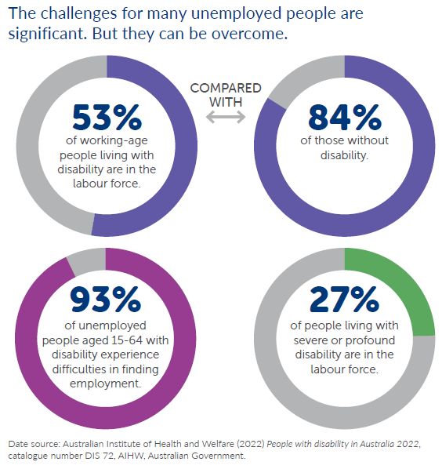
Employment rates haven’t improved in 20 years…for people with profound disability
Our response:
To overcome barriers and deliver benefits
for employees and employers
Notes:
Welcome to the new world of employment and the challenge we face in improving outcomes for people with disability in employment.
We know that for decades now the gap between the 53% of working age people with disability and the 84% without disability has remained largely unchanged.
We have accepted the challenge, have looked at employment through a different lens AND have a plan for positive change.
The following video provides an insight into where we’re going and I’ll then show you the journey we’ve commenced.

Slide 31

The new world of disability employment
Notes:
AFTER VIDEO PLAYS
We know employment offers so much more than a pay packet. It can enhance a sense of personal dignity, self-respect, financial security, friendships, personal and professional growth and more opportunities – aren’t these things we all want in our lives?
In collaboration with Community Solutions Group, Commercial partners and many others, we are supporting a growing number of people facing barriers to enter into or advance their employment AND we’re also helping employers create the right opportunities for a more diverse and inclusive workplace.

Slide 32
Endeavour Foundation Group
A new world of disability employment
Disability Social Enterprise
Supported Hosted Employment
Supported Independent Employment
Mainstream Employment
Many pathways to mainstream employment
Notes:
We have four primary employment pathways:
Disability Social Enterprise (AKA 28 Business Solutions sites) – where we offer tailored roles focused on training and employment in a highly supportive environment where people can choose to build a long-term career or use it as a steppingstone to more.
Supported Hosted Employment – is an opportunity for people to be employed in a mainstream workplace, with a high level of support from Endeavour on site and paid by Endeavour.
Supported Independent Employment is where people take the next step towards mainstream employment with some support as needed from Endeavour, but paid by another employer.
Mainstream employment is the ultimate goal for many and we support and celebrate this ambition knowing the journey may be short or long and will depend on the skills, experiences and needs of each person.,

Slide 33
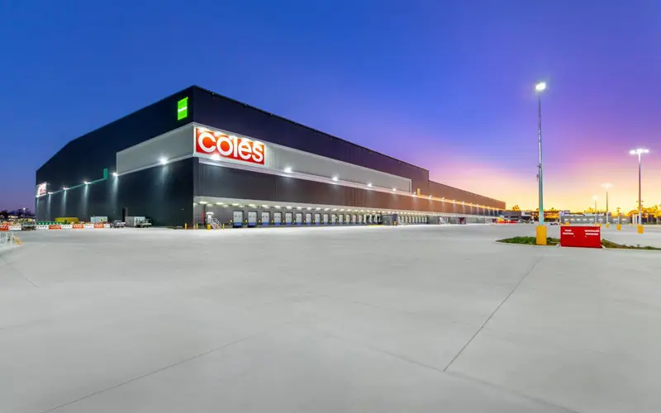
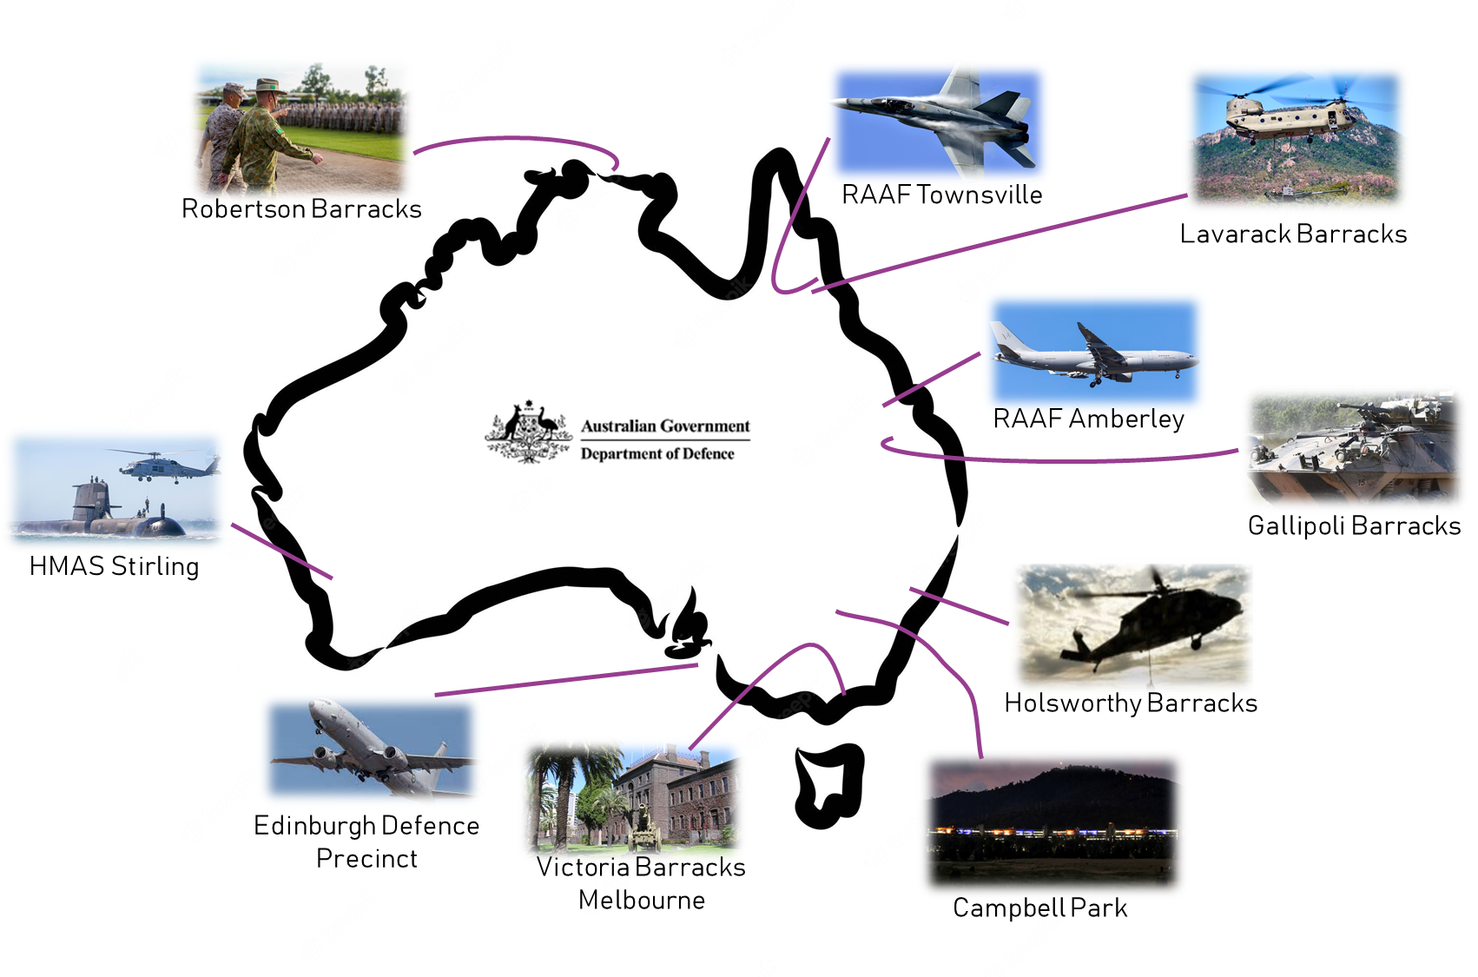

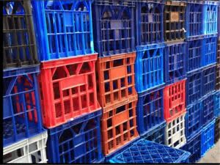
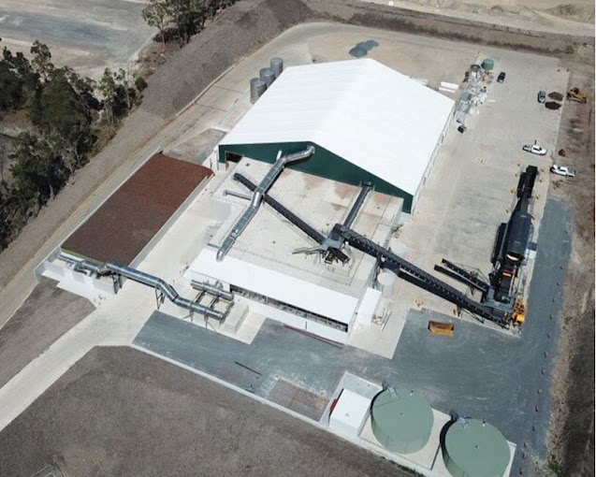


A new world of employment in action
7
100
6
Notes:
And here’s some we prepared earlier!
Defence Assistance Program (AKA DAP) – 100 people doing work as diverse as document management and bomb detection dog walking
Coles Distribution Centre for 7 people every day to re-sort milk crates at 100% accuracy and 4 times more proactively than any work team prior!
And
6 people at Phoenix Power who turn green waste into mulch and we support them by removing debris that can’t be mulched.
The journey is just beginning, there are some massive opportunities in the pipeline and there has never been a more exciting time to be involved with Work at The Endeavour Foundation

Slide 34
Questions?

Slide 35
People and Wellbeing Shannon Foley

Slide 36
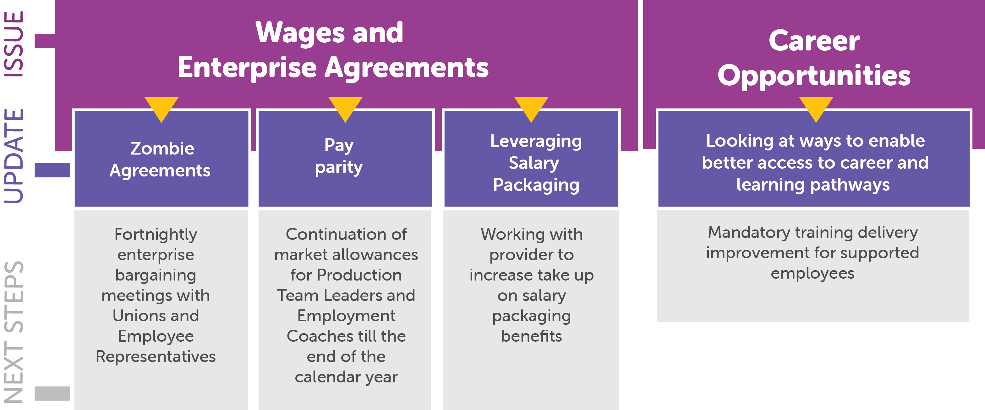
Since we last met…

Slide 37
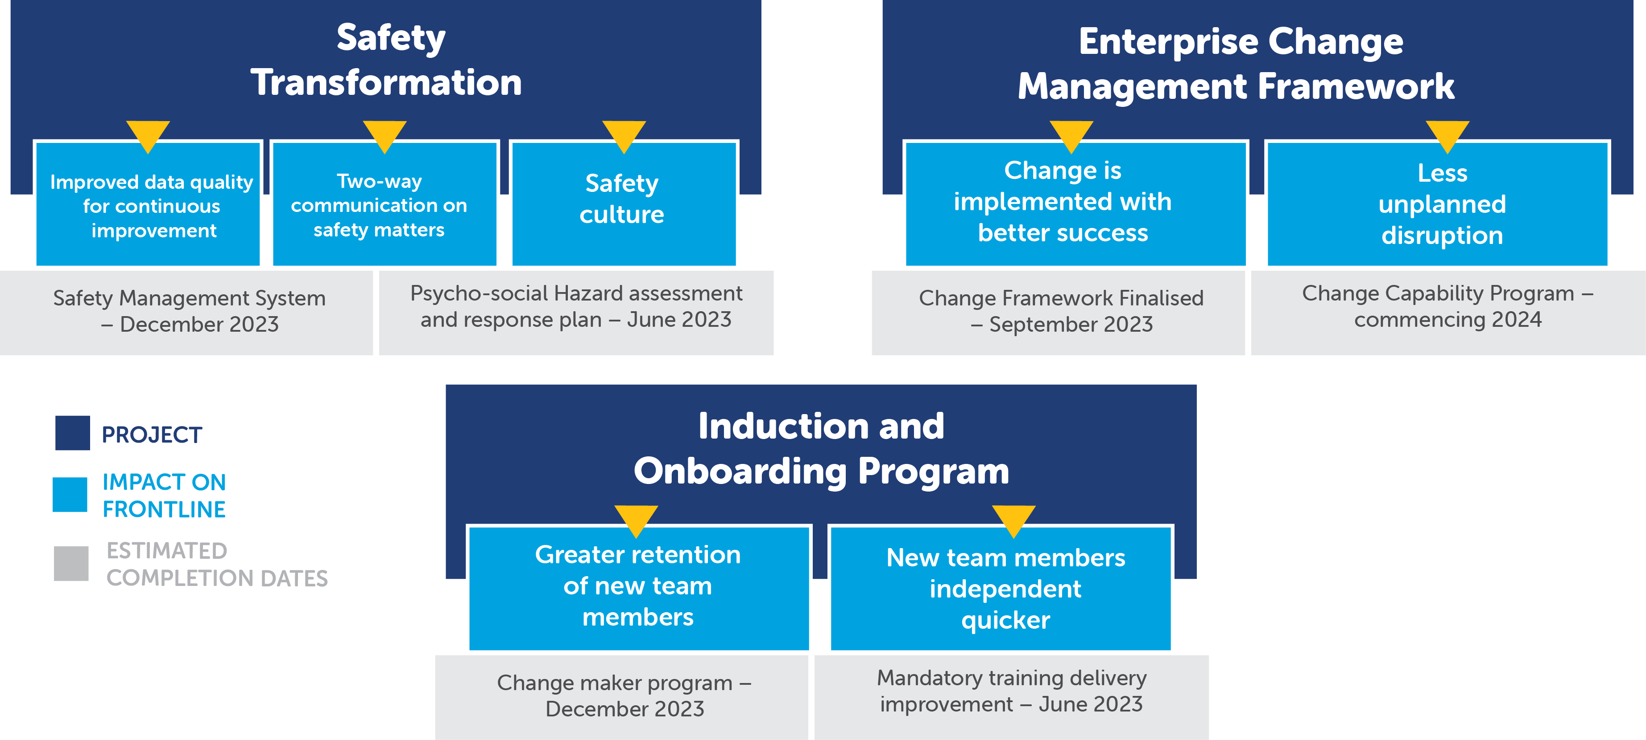
Key projects

Slide 38
Questions?
People Services and Payroll peopleexperience@endeavour.com.au
07 3900 5460
Learning and Capability learning@endeavour.com.au
Talent Acquisition careers@endeavour.com.au
Visit #TeamPossible support hub https://endeavour.service-now.com/supporthub

Slide 39
Ask us anything
The floor is yours!
Write in the chat or ask us directly.

Slide 40

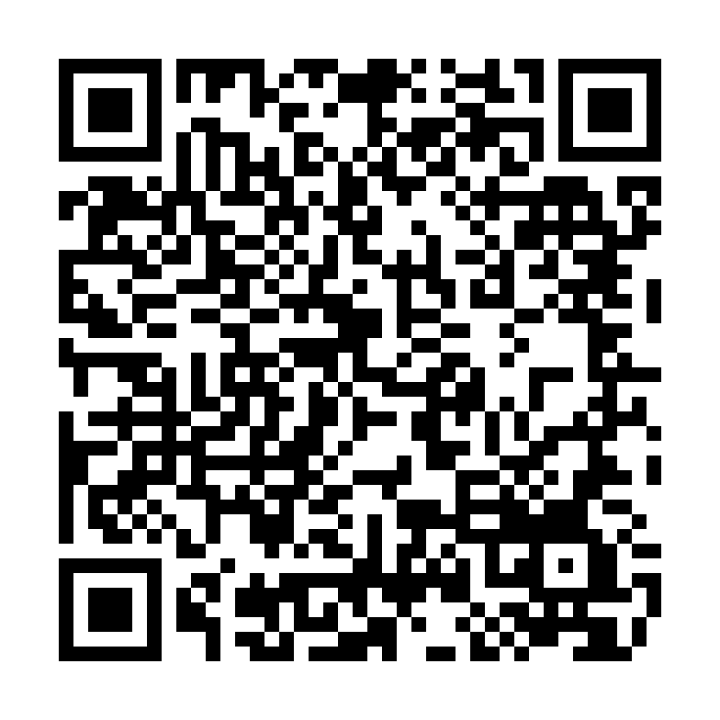
Next steps
Complete satisfaction survey
Read the questions and answers summary when received
Next Team Connect
February / March 2024
Have a question you didn’t get to ask?
  Email corpcom@endeavour.com.au
  and we will get your answer.
Notes:
Note that the QR code here is for the feedback survey – not Mentimeter

Slide 41
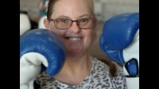
Just watch me!

Slide 42
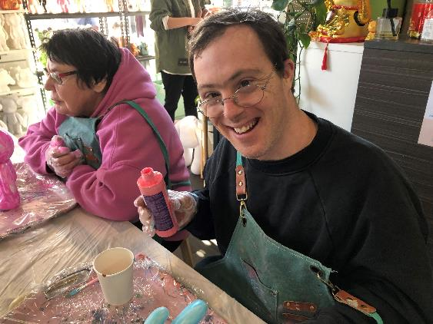
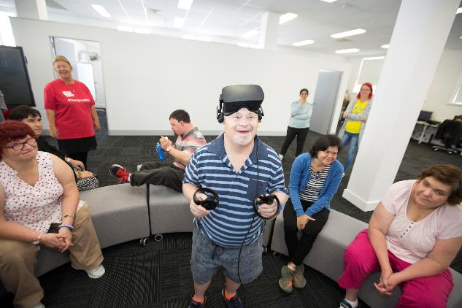
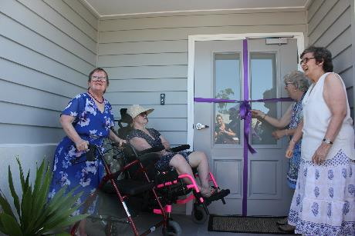
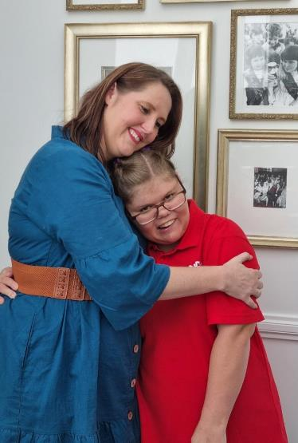
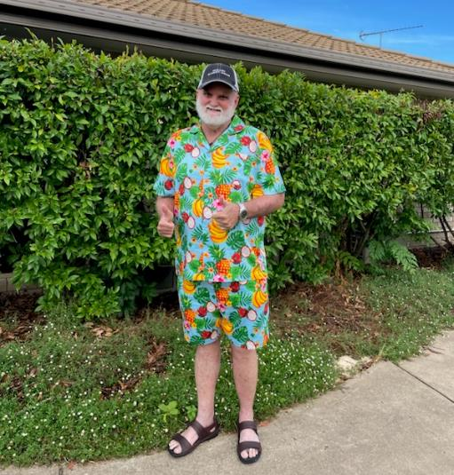
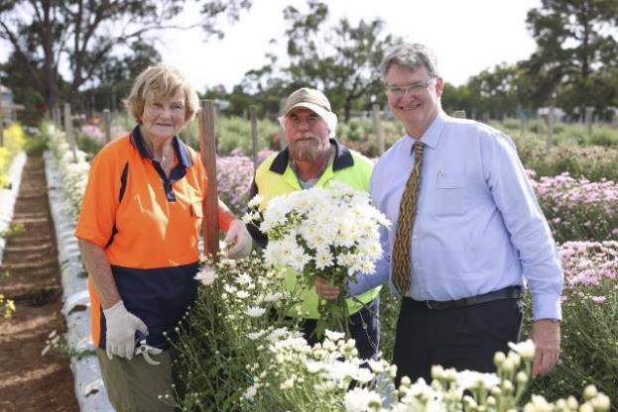
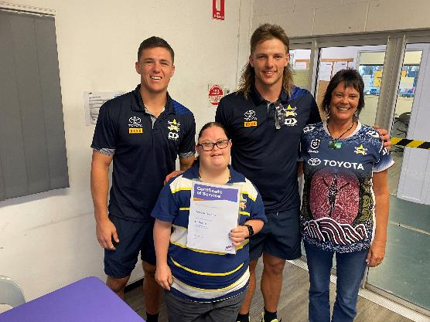
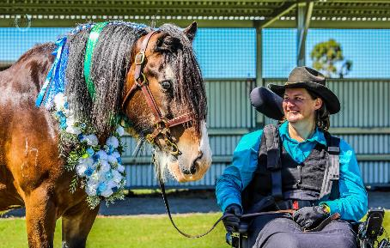
Thank you!
Notes:
Closing video

